Slide 1

Space to find ourselves: Supporting children and young people who hear voices and other experiences
Fiona Malpass, Mind in Camden
Zarah EVE , Manchester Metropolitan
university

Slide 2
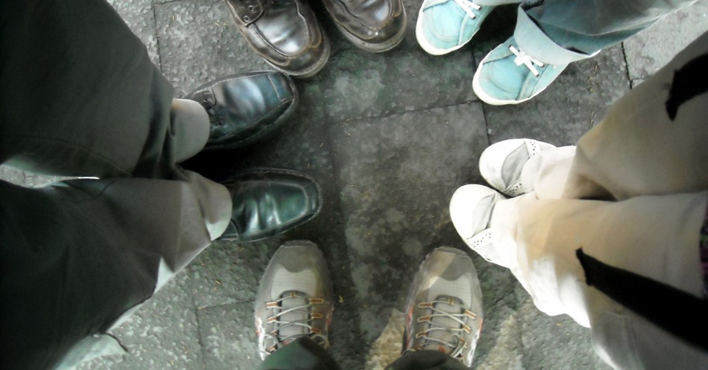
Welcome and introductions

Slide 3
Workshop outline
Young people and the worlds they live in
The diversity of experiences including multiplicity
Support available (voice collective)
Creative support
Meaningful involvement

Slide 4
The ethos
Voices, visions and other unusual sensory perceptions are meaningful experiences that are unique to the individual.
These are essentially normal, although unusual, human experiences which affect around 8% of young people.
Although some young people with these experiences become very distressed, this is not inevitable.
Difficulties in coping with the voices, visions and problems in an individual's life relating to these, are a key factor in levels of distress.
There are many different valid ways of understanding these experiences and, as such, it is important that individuals are supported to make sense of them in their own way.

Slide 5
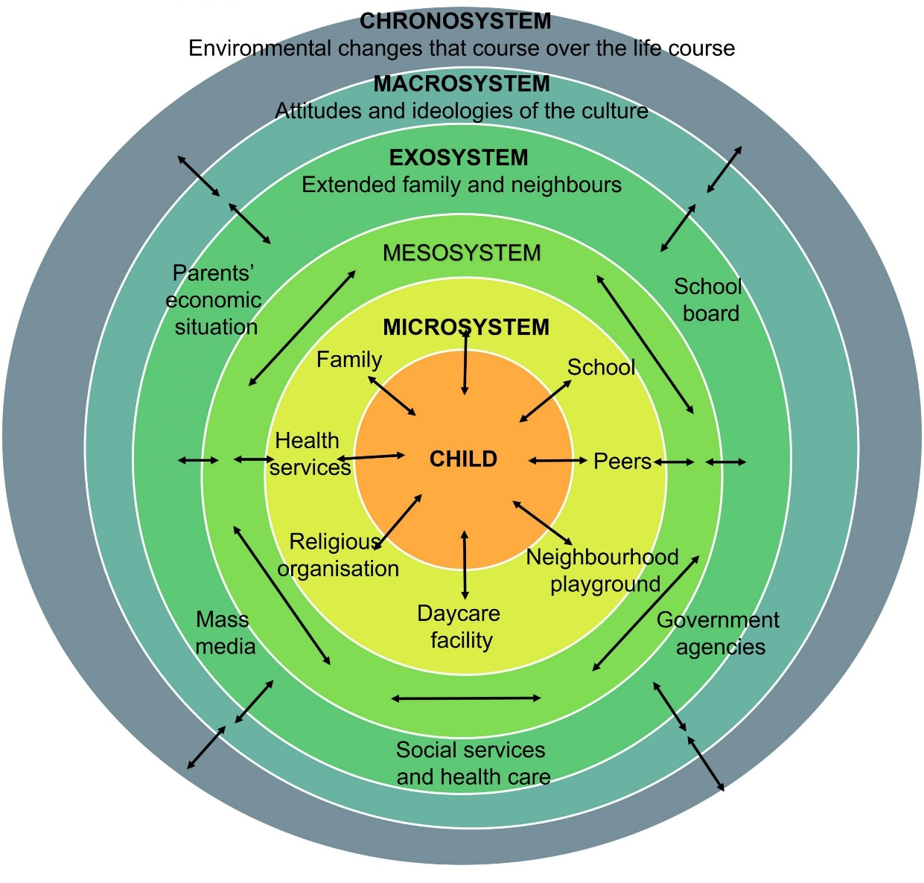
The ecosystems we find ourselves in

Slide 6
Existing in our own worlds
Young people rarely have space to make sense of the world on their terms, and are instead told about the world by powerful individuals and systems/institutions.
When the world feels unwelcome or hostile, existing in our own realities can be a way of coping or escaping. Voices can reflect these systems, or can be a source of support and comfort.
Sometimes in response, we can retreat into our own worlds - This can take the form of hearing things, seeing things, other sensory experiences, felt presences, unshared beliefs, multiplicity, and more…
At voice collective, we support young people with these experiences, as well as helping them find ways to navigate the ecosystems influencing their lives, offering advocacy and solidarity.

Slide 7
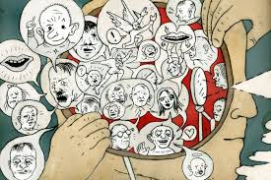
Thinking about Hearing voices and related experiences
Can represent feelings or be an expression of distress
Commonly associated with feelings of shame, and secrecy
Can be related to difficult life experiences
Can be difficult to describe and articulate
Have meaning and significance
Don’t exist in a vacuum
Highly stigmatised
Can be helpful/comforting
‘A sane reaction to insane circumstances’

Slide 8

What is multiplicity?
The experience of having more than one person, self or identity within the body
We all have different parts of ourselves e.g., acting differently to a boss than to a friend
But for multiplicity, the experience of having different selves is much stronger and involves having separate identities
Selves can have different thoughts, feelings, memories, genders, ages, and experiences

Slide 9
How do young people make sense of multiplicity?
Multiplicity has some similarities with dissociation experiences, but people highlight the non-clinical, not diagnostic, holistic nature
Young people often talk about the journey to understanding their multiplicity experiences
Consider a house-share with multiple people – all people who live in the house have individual experiences and identities
Multiplicity describes the experience – it is not a diagnosis (however some people do have a diagnosis e.g., dissociative identity disorder, or other specified dissociative disorder) – this can be helpful for some, but not a requirement

Slide 10
How do they experience multiplicity?
Young adults have shared their experiences of multiplicity as being:
Life-enhancing
Fulfilling
Supportive
Confusing
Protective
There is often shared head space so other selves are aware of what the body is doing
There is a sense of family and protection across narratives – having internal support can be invaluable
There is often a lack of amnesia between selves, which can help people’s understanding and day-to-day living
People often have positive internal communication so will structure their time between selves, allowing different people to be “in charge” of the body

Slide 11
Being supported with multiplicity
Many young people report not wanting to remove their multiplicity, but seek support to live well with their experiences
Currently there is minimal understanding outside medicalised knowledge, so people are sometimes fearful of sharing their experiences
It is a big decision for people to share their full lives with others – and they hope people respond with openness and support
Accepting individual understanding and conceptualisations is key to people feeling validated and understood
Allowing people space to explore their experiences can help develop positive day-to-day living
Peer support is seen as valuable for many young people who experience multiplicity

Slide 12
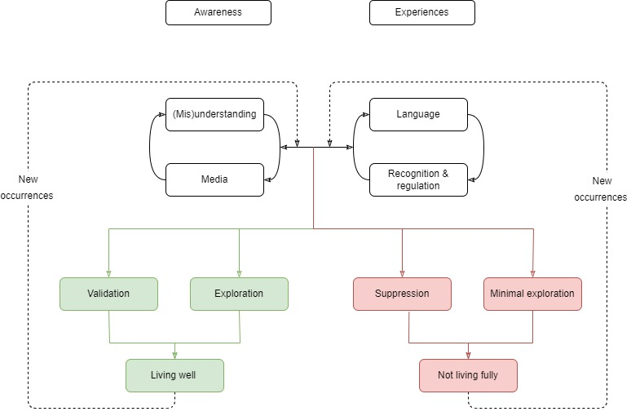
Being supported with multiplicity
Young people will not seek help if they believe their experiences are going to be undervalued and not listened to

Slide 13
Barriers to getting support
Stigma (self-stigma and perceived stigma from others)
Not seeing their multiplicity, or voice hearing as problems (but others assuming they are)
Not knowing where to get support or lack of access to support
A cultural perception against help seeking
Negative experiences of trying to get help in the past
Negative responses from others following disclosure
Fears of not being believed
Fears of being medicated or hospitalised
Not knowing how to describe what they are experiencing

Slide 14

What do we mean by working creatively with young people?
Notes:
What ways do you work creatively with young people?

Slide 15
It can mean all sorts of things…
Collages and picture boards
Games
Humour
Role plays
‘Outside of the box’
Adaptable
Story telling/fiction
Memes
Apps
Painting
Drawing
Music
Poetry
Photography
Drama
Flexibility
Individualised
Pop culture references
Different

Slide 16

Benefits of working creatively with young people
It can be inspirational or motivational
Builds confidence in expressing their views, ideas and feelings
Builds rapport (both individually and in groups)
Encourages greater levels of engagement
Offers alternatives ways of working
Gives different methods of self expression
Exploration of coping strategies and ways of thinking

Slide 17
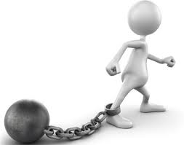
Are there any drawbacks?
Young people can become used to a particular way of working, or being worked with.
Young people may feel too shy or self-conscious to engage in some activities
Peer pressure/negative perceptions of the activities
Activities need to be targeted at the age group and needs of the young people
Young people may not feel motivated to participate

Slide 18

How can we use creativity in our work?
Notes:
Adapting our approach to each individual we work with
Being flexible and open to suggestions from the young person
Using different activities and strategies
Group activities
Utilising popular references

Slide 19

Different ways of seeing the world
Notes:
Can be difficult to explain your drawing…

Slide 20
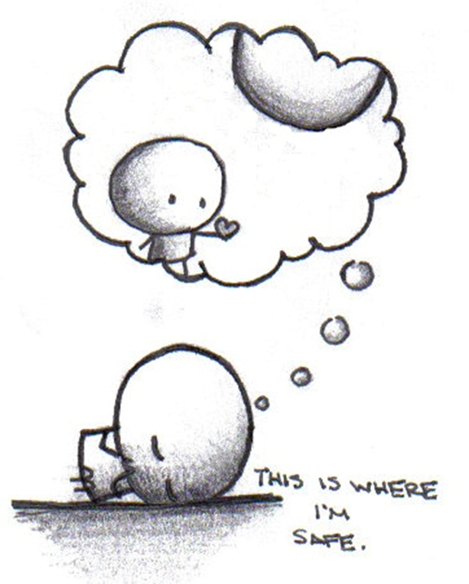
Talking. how easy is it?
Difficulties talking about experiences can be for many reasons,.
There can be an expectation or pressure for the young person to talk, which can serve to further block them from feeling able to speak.
Working together in a creative way with the individual, can help create a safe space and find a form of self expression which they are comfortable with.

Slide 21
How we can help
Help them find their own voice
Independence and empowerment
Creativity
Coping strategies
Being alongside them

Slide 22
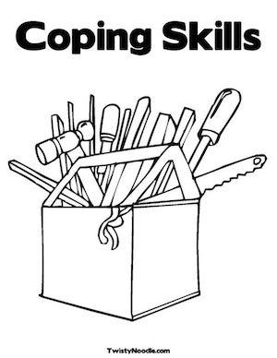
Coping strategies
How do you cope if you feel distressed?
Write down 3 of your personal coping strategies.

Slide 23
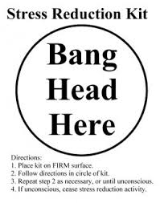
coping strategies
All young people who struggle with voices will have some way of dealing with them
This might, to the people around them, seem strange or unhealthy
Before looking at new ways of coping, try and understand what a young person is already doing
Value it as a creative attempt to survive, and look at its FUNCTION. This gives you both a clue for what else might help.

Slide 24
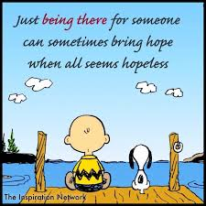
It’s not all about coping strategies
We are influenced by Gail Hornstein, a professor of Psychology from the US,who drew the following common themes from recovery narratives
Being believed
Being listened to
Having an empathic witness to your suffering
Having at least one person who believes in your capacity for full recovery

Slide 25
Making sense of voices
If young people struggle to understand the voices they hear, they can seem more powerful than they really are.
If a young person feels confused about what their voices are, why they hear them, and doesn’t know what helps and triggers them – it can really useful to support them to explore their experiences and begin to make sense of them.
Engaging with and getting to know voices can be useful
Remember: It’s is the young person’s journey, and their perspective counts.

Slide 26
Making sense of voices
There are different strategies and tools that can help young people make sense of their experiences. These include:
Voices/Experiences Diary
Maastricht Interview for Children (available via Intervoice website)
Timeline
Scrapbook
Comparing life story with voices and other experiences – looking for themes
Voice profiles

Slide 27

Support at voice collective

Slide 28

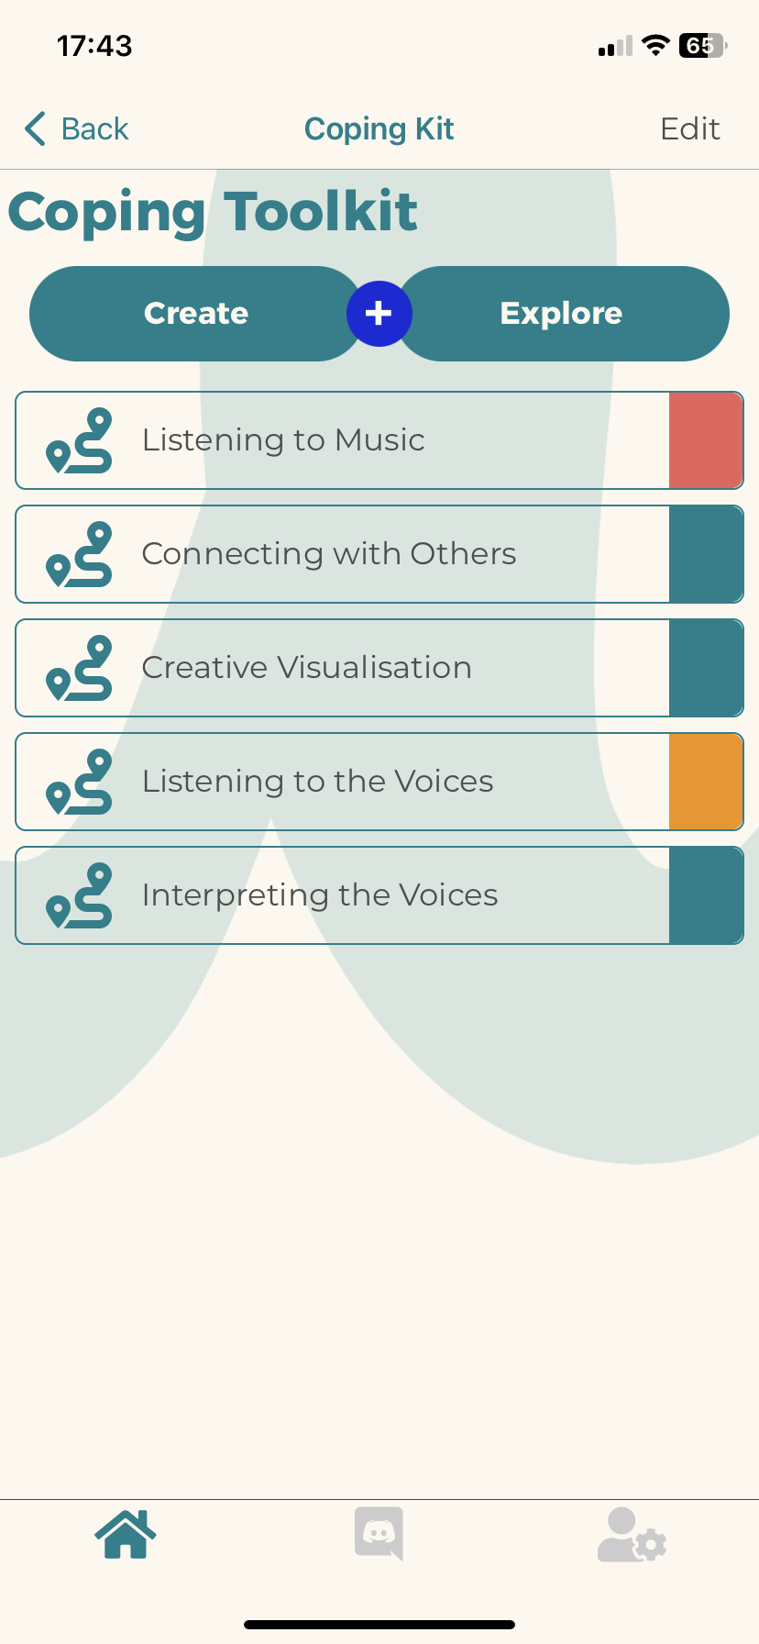
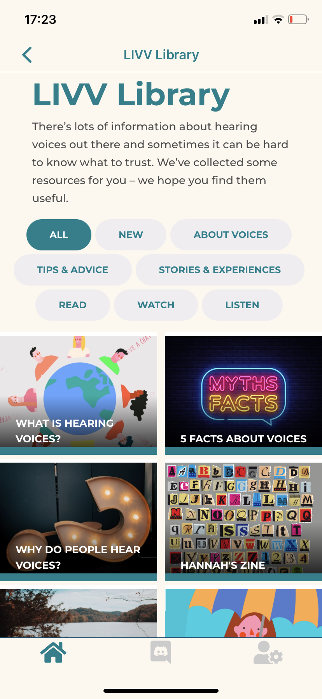







Provides access to normalising and de-stigmatizing information about hearing voices, personalized coping strategies & peer support
(not used as part of clinical treatment) for young people who hear voices irrespective of diagnosis

Slide 29

Peer support groups
Weekly group for 16-25 year olds
Monthly group for under 15 year olds
Monthly group for UK University students
Monthly group for parents of voice hearers under 25
Monthly group for parents of voice hearers aged 19 and over

Slide 30
One to one work
At voice collective we offer one to one support to young people under the age of 25 and their families
This can be on zoom, in person, by email, or by phone
This can range from regular support, ad hoc support
Not therapy or counselling
Involves being alongside, listening, empowering, being curious and empathetic

Slide 31
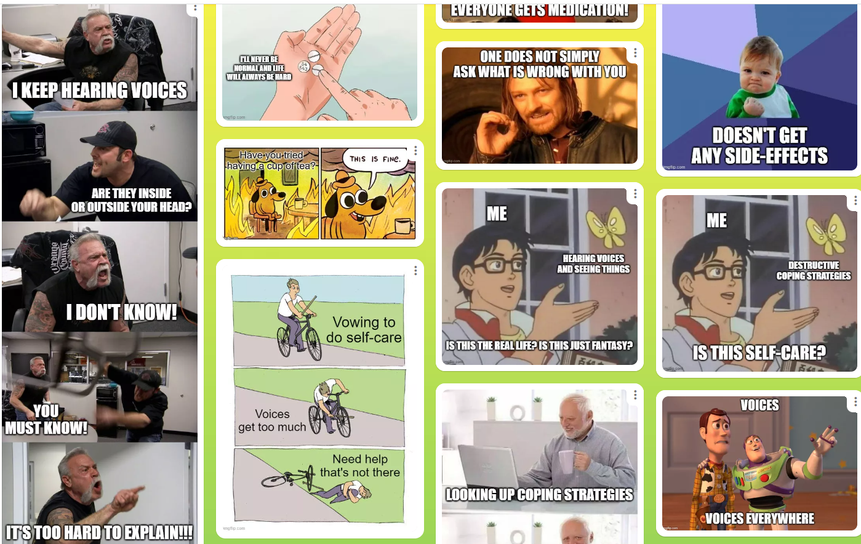
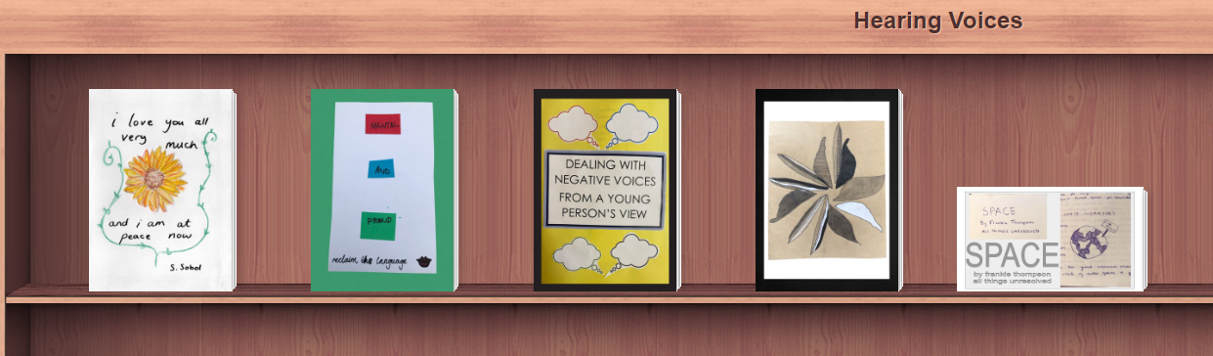
Creative workshops
Zines
Poetry
spoken word
Animations
memes!

Slide 32
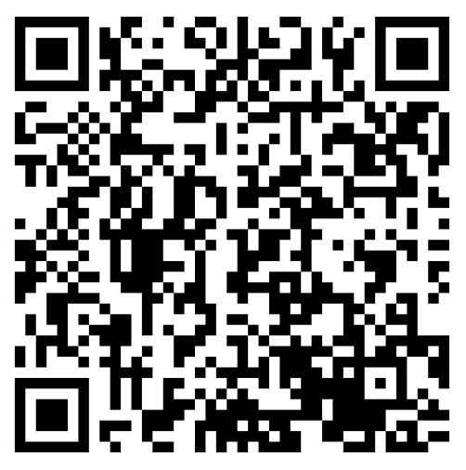
Why a meme workshop?
Creativity and understanding voices
Memes = young people communication
Humour and mental health
Engaging online

Slide 33

Discord server
An online platform to connect young voice hearers across the world
A format that lends itself to community and peer support
‘soft launch’ to pilot the server
Created with young people and supporters of young people

Slide 34
Focus groups / steering groups
Influencing research (special interest research groups, leading on PPI for projects)
Giving young people a platform to be heard and to have a say in research and services
Young people giving feedback on our work and steering the direction of the project
Encourage meaningful involvement and for young people to be paid for their expertise and experience

Slide 35
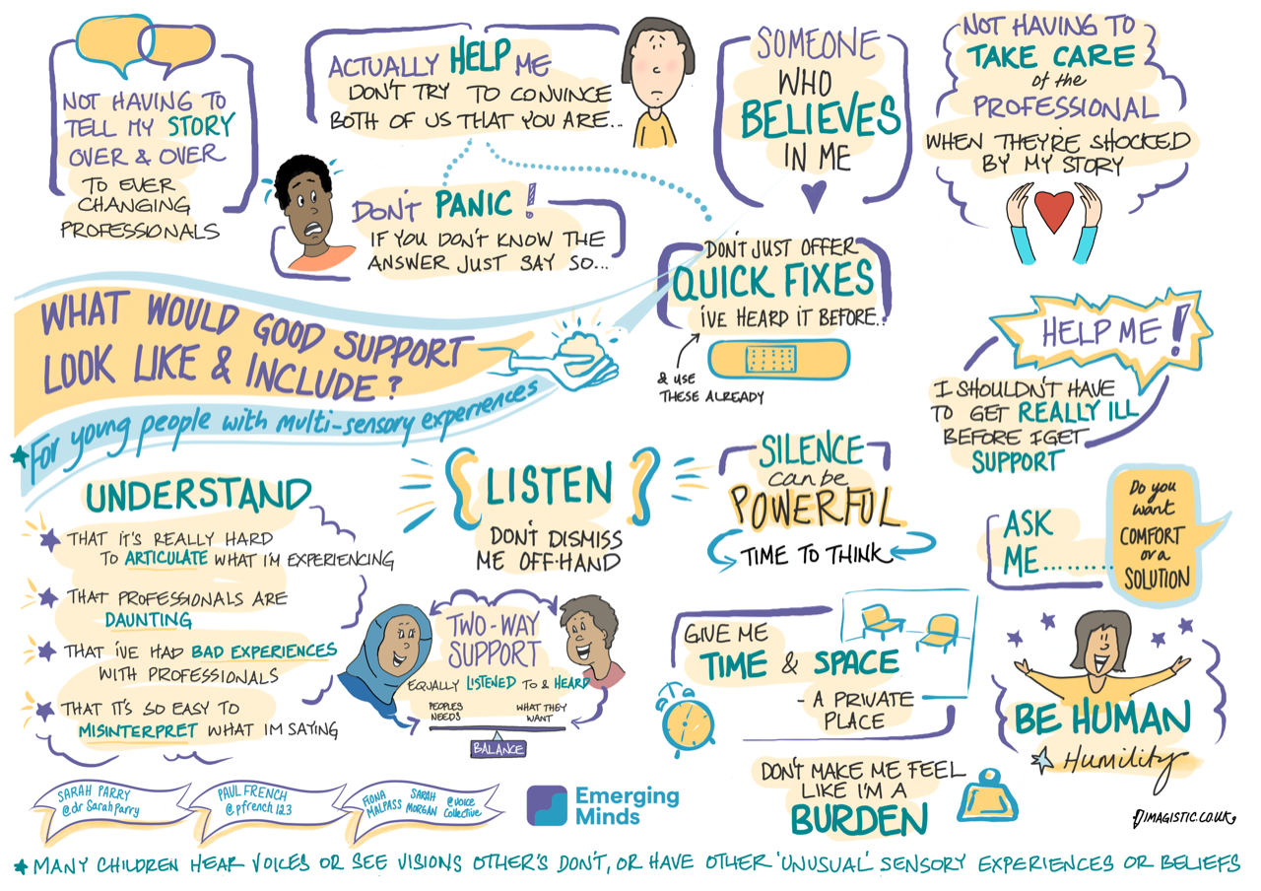

Slide 36
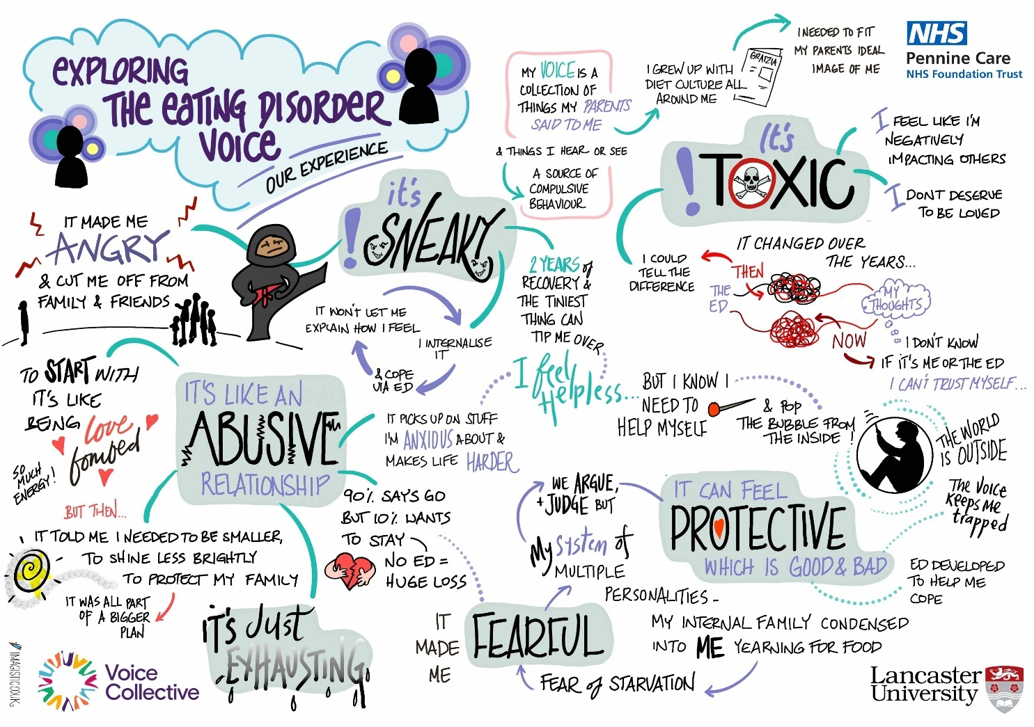

Slide 37
Take Home Points
Working creatively isn’t just arts and crafts, it’s about being flexible and adapting to individuals.
Involve young people or even better, be led by them
Voices, multiplicity and other experiences can be explored on a deeper level, and creative methods can help with this.
It’s okay to not always focus on voices, it helps to explore everything within the young person’s life context.

Slide 38
Contact us
Voice Collective, Mind in Camden Barnes House, 9-15 Camden Road London, NW1 9LQ
Tel: 020 7911 0822| Email: info@voicecollective.co.uk
Web: www.voicecollective.co.uk
www.facebook.com/voicecollective www.twitter.com/voicecollective

