Slide 1


Veteran Voices & Visions: Adapting the Hearing Voices Approach to the Veteran Affairs, Greater Los Angeles Healthcare System
Ippolytos Kalofonos, MD, PhD, MPH
Erica Fletcher, PhD
Veterans Affairs, Greater Los Angeles Healthcare System
UCLA/VA Center of Excellence for Veteran Recovery and Resilience
UCLA Jane and Terry Semel Institute for Neuroscience and Human Behavior

Slide 2
Disclaimer
The views and perspectives expressed here are my own, and do not represent the Department of Veterans Affairs.

Slide 3
Workshop Aims
Background
Describe the adaptation of Hearing Voices within the U.S. Veterans Affairs (VA) context as a clinical intervention.
Present data from preliminary pilot study on initial groups.
Present perspective from group participants.
Discuss plans for ongoing research and evaluation in collaboration with VA clinicians, peer support specialists, and voice hearers.

Slide 4

Background
From Medical Anthropology to Psychiatry
https://www.ucpress.edu/book/9780520289406/all-i-eat-is-medicine
Notes:
I was an MD PhD student in anthropology interested in the AIDS epidemic. For my anthropology dissertation I studied the community response to the scale-up of antiretroviral treatment in Mozambique in the 1st decade of the 2000s. I worked in Mozambique as an anthropologist for several years, and I immersed myself in the culture and the social life - I learned the colonial language - Portuguese - as well as Chiteve, the indigenous language; I learned the history, I learned about the various religions, and of course about healing and illness. I got to know indigenous healers, church-based healers, doctors, nurses, and I got to learn about the many ways people understood disease – not only in biomedical explanatory frameworks, but also in terms of ancestral spirits; the devil and the holy spirit; witchcraft; where illness was often understood as caused by a disturbances to social harmony, and social relations. How the history of colonialism shapes health and illness and especially shapes experiences with biomedicine.
I spent most of my time with people living with HIV/AIDS. They faced a lot of stigma and exclusion. In response to that, they created support groups that they ran in the community that functioned as emotional support, education, and mutual aid groups
Many of the leaders of these support groups became activists, outreach workers, and peer specialists who were employed by the AIDS programs.
These groups were often places where people came together to discuss the problems they faced, and they built on their lived experience and on diverse frameworks to understand illness, to support each other, and to collectively create ways to cope and thrive.
I recently published this book-length ethnographic study based on this work and the cover has a picture of one of these support groups .
I think this experience in Mozambique actually set me up to choose psychiatry as my specialty rather than what I thought I was going to do - primary care or infectious disease, b/c after I finished the PhD and came back to medical school, psychiatry felt like a place I could do the kind of deep listening I aspired to do as an anthropologist.
When I was in training, as a psychiatric resident, I used to sit down with patients who were in the hospital and try to make sense of their experiences. I was discouraged from doing that, as all they needed was treatment; they wouldn’t remember any of our interactions and I might make them worse or I might validate their delusions.
Now I’m inside a mental health treatment system and am trying to develop an approach that builds on the expertise of lived experience, group solidarity and support, and that pays attention to diverse frameworks of understanding illness. And that is what the intervention I’m discussing today is all about.
My approach is a form of clinical ethnography. As a dually trained anthropologist and psychiatrist, my approach is both clinical and ethnographic, in that each person’s inner world can be conceptualized as a unique culture with its own history, language, values, and symbolic systems (Lester 2022). Working with an individual entails an ethnographic exploration of that individual’s inner world, a process that takes time, patience, and development of trust.
Working within a critical medical anthropological framework, I understand explanations of pain and suffering as potentially associated with the larger social, and political-economic orders, and attempt to bridge personally expressed lived experience and meaning to the broader social forces that structure, define and constrain that lived experience. (Scheper-Hughes and Lock 1991, 1986:137).

Slide 5
VA Services
VAGLAHS serves Veterans residing throughout five counties: Los Angeles, Ventura, Kern, Santa Barbara, and San Luis Obispo. There are 1.4 million Veterans in the VAGLAHS service area.
West LA VAMC
Patient Aligned Care Teams
Intensive Case Management
Psychosocial Rehabilitative services
Medication Clinic
Cognitive Behavioral Therapy for Psychosis

Slide 6
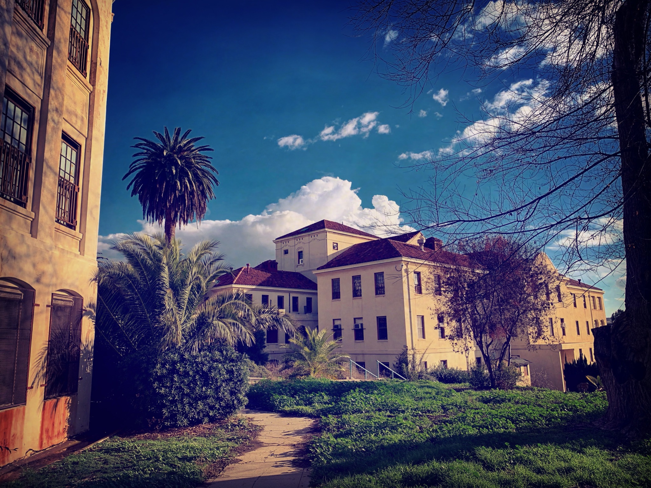
Photo of the West LA VA Campus; Jared Greenberg, MD
Why bring HV to the VA?
Largest national healthcare system in the U.S.
Expansion of tele-mental health services during COVID-19
Robust employment of Veteran peer support specialists
Veterans are accustomed to research alongside clinical treatment
Unique camaraderie among Veterans
Psychosocial Rehabilitation & Groups offered

Slide 7

Challenges
Biomedical orientation
Marginalized Peer position
Voice Hearer = patient, not leader
Evidence-Based Practice orientation

Slide 8
Timeline
2018
1st HV training at VA
1st Pilot VVV group
2019
Funding via K12 Award
Veteran Engagement Group Feedback
2020
HVN trainee recruitment at VA & UCLA
2021
2nd HVN training
10 trainees co-facilitated 5 VVV groups w/29 Vets
2022-23
Community Advisory Board driven adaptation
Notes:
2018
1st HV training at VA – Nev Jones
First Veteran Voices & Visions group begins w/ 3 Veteran Voice Hearers & 2 VA clinician facilitators
2021
2nd HV training at VA in January – Wildflower Alliance (Cindy Hadge & Tim Laprade)
10 trainees facilitate 5 VVV groups w/29 Veteran participants –
1 Veteran voice hearer facilitator, 5 Veteran Peer facilitators, 4 clinician
Pilot study
2023
Community Advisory Board process adapt manual and training for Veterans
Training – 2nd Veteran voice hearer facilitator
Important for us to collaborate with experts-by-experience; both trainings given by experts with lived experience, and we’ve solicited feedback from Veterans every step of the way and are doing our best to incorporate Verean Voice Hearers and expetrts by experience at every step

Slide 9

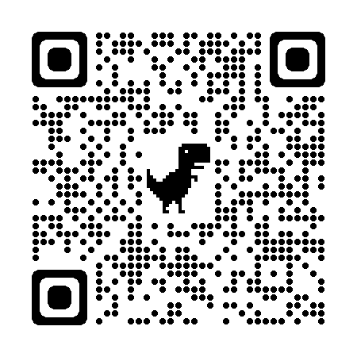
Veteran Voices & Visions Pilot Study, 2021
5 VVV groups w/29 Veteran participants
Co-facilitated by a Mental Health Clinician & Peer
Groups ran for at least 16 weeks
Most have continued for ~ 2 years
Virtual
Outpatient & voluntary
Max of 6 group members
Pre & post intervention assessments conducted
Qualitative interviews on how Veterans understand their experiences and the groups
Standardized surveys
Notes:
QR code links to the study we published in InternationL Jo of Social Psychiatry

Slide 10

Veteran Participants
83% Men, 17% Women
51% Black, 29% Latinx, 11% White, 9% API
Mean age 43 y/o (range 25 – 68)
Most currently housed but nearly all were unhoused at some point
All given a “psychosis-spectrum” diagnosis
All currently prescribed antipsychotic medication
>80% with at least 1 psychiatric hospitalization
Various kinds of trauma
Notes:
Combat related
Military sexual trauma
Military hazing
Childhood/non-military

Slide 11

Preintervention Interview
Diverse Frameworks & Experiences
Biomedical (including some uncertainty)
Abusers / Verbal Assaults & Criticism
Some related to past trauma: sexual/emotional/physical, childhood, military, etc.
Surveillance from neighbors, powerful forces, unknown others, using technology, etc
Spiritual / religious
Ancestral / familial
Psychological
Notes:
Before Veterans had attended a group, we conducted qualitative interviews about how they understood their experiences.
Many said they understood them as a part of an illness, unsurprisingly, these were patients in VA mental health clinics
Click 1 but most also had additional explanatory frameworks; or they felt that multiple explanations of their experiences made sense, or that calling it an illness didn’t quite account for everything that as going on.
These were some of the frameworks people had prior to joining these groups
Most people predomiantly described negative experiences, but some were positive, and described

Slide 12

Preintervention Interview, Cont.
Largely negative, but some positive experiences
Benefits:
Guidance & protection
Solace & company
Growth & change
Insight into the essence of the self/world, etc.
Strategies & tactics for living with these experiences

Slide 13
VVV groups reduce distress due to voices as measured by the Psychotic Symptom Rating Scale (PSYRATS) Voices Subscale
PSYRATS Hallucinations score
Mean = 29.1
Mean = 23.0
Significant effect of time: F(1,21) = 9.050; p = 0.007

Slide 14
VVV groups reduce “omnipotence” and “malevolence” & increase “beneficence” attributed to voices on the Beliefs about Voices Questionnaire (BAVQ) – BMO composite score
BAVQR-BMO score
Mean = 29.8
Mean = 26.9
Significant effect of time: F(1,15) = 6.486; p = 0.022
Significant wave x cohort effect: F(4,15) = 5.928, p = 0.004
Notes:
Beneficence = good
Malevolence = evil
Ominpotence = all knowing and all powerful

Slide 15

Veteran Experiences of VVV Groups
Discovery
Overcoming shame
Hope
Connection
Safe space to be curious & honest
Reframing
Acceptance
Self-understanding
Exploring alternative frameworks
Negotiating new relationships
Change
Pursuing life projects
Hornstein, Gail A., Emily Robinson Putnam, and Alison Branitsky. “How Do Hearing Voices Peer-Support Groups Work? A Three-Phase Model of Transformation.” Psychosis 12, no. 1 (2020): 1–11.

Slide 16
Hope
“a lot of people were hesitant to initially join in. There was trepidation.…it's difficult to talk about this, to be honest…. It is strange to hear about other people talking about their situation. I’m so used to being alone and being like the leper… it was refreshing, invigorating. It gave me hope. The focus is on everyone’s personal journey.”
“when you can see that it’s not just you, it’s lots of other people and people can lead successful lives, that really helps your outlook. It’s nice to finally see a light at the end of the tunnel.”
“Just listening to everybody else gives me hope…. If they can go through it, I can go through it. Since I’ve joined the group, I’m not hopeless.”

Slide 17
Connection
“I like hearing other Veterans describe their experiences. I don’t feel so alone in it. For a long time, I just thought: What’s wrong with me? I thought it was just me.”
“I’m not alone in my struggle…I want to hear what everybody else has to say about the same demons I deal with…I think about my brothers all week long, when I’m going through what I’m going through. ”
“I guess I wanted to talk about it, but I never really knew I wanted to talk about it until I came to the group.”

Slide 18
Safety
“I haven’t had an experience with any medical professionals talking about the specificities of what’s happening. Usually, they just talk about these things in general terms, you’re seeing things, you’re hearing things, so we have to get you these medications. But it’s different to talk about what’s actually happening, what we’re actually seeing and hearing, and what it might mean to us. And hear about other people’s experiences. It’s just more human, to me. I feel like a part of the conversation and we’re all working through these things together and seeing what we can do. It’s different because a lot of times medical professionals can make you feel like something’s wrong with you.
Notes:
Experiencing the group as a safe, novel space to explore experiences in detailed ways:
Veterans in the mental health system know that saying the wrong thing to the wrong person at the wrong time can result in an involuntary hospitalization, medication change, etc. .

Slide 19
Relational Acceptance
“I don't really hope for them to go away, but I just hope to be able to live with them. Like, you're not going to try to mess up my day and I’m not going to try to mess up yours.”
“Thank you for your concern.”
Notes:
The second quote – example of someone talking directly to their voices, addressing them in a relational way. He realized his voices are trying to protect him, but they end up overreacting and constantly warning him of dangers even

Slide 20
Self-understanding
“Maybe schizophrenia is just how our brains work for the unconscious, communicating with the conscious mind. Maybe people with schizophrenia, they dream while awake.
Like with someone being born deaf, they just got to deal with it. That’s their life. That’s their reality…it could be a disability, if it gets out of hand, but it’s up to each individual to balance it and manage it
It’s just when you try to talk about this topic, people get like: ‘What? That’s not right. That’s wrong. We’ve got to fix it. We need to increase the dosage, blah blah blah…’ Hey, it’s not necessarily a thing that needs to be cured!”

Slide 21
Alternative Frameworks
“I had a vision that totally changed my relationship with my family for the better. It was a projection of my grandfather, telling me: ‘You know, your family loves you.’ Either it was the ghost of my grandfather, or just a mental projection, through schizophrenia. Ever since then, I’ve been closer to my parents and my family. That’s why I think maybe it’s just how my unconsciousness speaks to me, through schizophrenia.”

Slide 22
Negotiating New Relationships
“It’s been helpful in understanding why I feel things that I feel, when I see them and hear them. Why I’m having these particular visions and hearing these particular things. I never really thought about how it might tie back to the past. Traumatic stuff from childhood. It’s nice to begin to think it through, you know, and see how this stuff is growing, changing.”
“I don’t really feel too many negative emotions towards them [the voices] anymore…I’m a little less terrified of life, a little less depressed...now I understand the voices as my brain trying to make me feel better. It’s been nice to experience them in different ways, you know? And learn and look at them differently.”

Slide 23
Reframing
“Maybe the way we have gone about it isn’t necessarily the most correct way. Because we see it purely as an illness, just like getting a staph infection. You got to treat it. But it’s not like a staph infection. Even though these things, a lot of them have roots in trauma, one thing about trauma is that it changes who you are, forever. And, you know, this is who you are. It changes who you become and it’s a part of you. Forever. You can’t just cure it…It’s not that something’s wrong with me, it’s that something happened to me. You know, the people that did the wrongdoing, they’re the ones that are wrong, it’s not that something’s wrong with me. That at least helps me a bit on my mental health.”
Notes:
This last statement is something of a motto in the Hearing Voices movement: It’s not that something’s wrong with me, it’s that something happened to me
Move away from locating the pathology in the individual, but as connected to relationships

Slide 24

VVV Stories of Change
Life Projects
Self-understanding
Relationships
Education
Employment
Housing
Notes:
Here, I don’t have a single quote but we have many observations that the Veterans in these groups, as they build trust and get connected, and become regular attendees of the groups, they bring their daily challenges, their life projects to the group, and talk about how things are going, they get advice, and they share successes and failures.
Several Veterans told us they opened up to others in their lives about their experienced and experienced new forms of support and validation; a couple told us they applied for new jobs as a result of the confidence the groups instilled in them.
They check on each other. Some of them have exchanged phone numbers and connect outside of group. Some Veterans are working on finding stable housing; others on dating and finding a significant other; others are looking for employment; housing, trying to get back to school. Some are seeking a purpose in life trying to move out of their parents’ house or out long-term care or supportive housing. We’ve had Veterans join groups while they are hospitalized on the psychiatric unit. They receive help from each other and the give each other help, and many can see that they are doing both, and I think that is what keeps them coming back.

Slide 25
Facilitator Growth - Clinicians
“This is a more process-oriented group. For me, it’s a breath of fresh air. In psychoeducation, I do most of the work and the talking. It’s good to step back and let people talk about their experiences and not jump to challenge, to explain, or to change [them].”
“The longer I do my job, the more I learn that diagnoses are theories, and our knowledge is not finished or complete.”
“As a clinician, I use [psychiatric] language to describe client experiences . . . But in my culture and within my family, we are all driven by something, a presence in our mind and spirit that moves us. Spirits or ancestors are guiding me. I try to honor them.”
Notes:
All quotes from clinicians
Opening up a space for clinicians to be a bit more human and connect in different ways.

Slide 26
Facilitator Growth
“It’s an approach that puts people on the same level, as peers. I’ve always had to assess for risk and educate and look at issue as symptoms. Just looking at these experiences as just life experiences that don’t have to go away, just living the best life you can with the voices. I can also share and talk as another human being. It is very comfortable. I feel like I’m being myself, more authentic a little bit more, and I don’t need to have all the answers.” - Clinician
“It helps me not judge others. I used to think people should just take their meds, but now I see that experience - that right to live in an alternative state – and I want to ask, ‘How can I help you live more successfully in the way that you want?’” - Peer

Slide 27
Facilitator Growth
I really wish this training were mandatory for employees who interact with veterans at the VA. I have too many colleagues who seem afraid of veteran voice hearers or other so-called "psychotic" veterans. I have always lived with this very deep-seated fear that I could one day become "schizophrenic" since it is in my immediate family and I have had some early childhood experiences hearing voices. My understanding of schizophrenia was that it was completely disabling, that you could not lead a fulfilling life, that you either were terrorized by your voices or were sedated on anti-psychotics. After meeting the voice-hearers and hearing their stories, I feel so differently about it now, less afraid of what my own unusual experiences "mean," far more skeptical of the diagnosis, and more reassured that if I ever begin to hear voices, I do not have to be so afraid for my future.
- VA staff

Slide 28
Summary Experiences
Embraced by Veterans & VA staff
Encourages Veterans to define their own experiences and seek personal interpretations and holistic coping strategies
Groups can be safe, nonjudgmental spaces, foster meaningful engagement and discussion, reduce shame, distress, & isolation
Diverse explanatory models are common and offer opportunities:
to explore what matters for patients
to develop helpful and interpersonally coherent narratives
Valuing voices as “messengers” that embody real-world issues can provide opportunities for self-understanding & growth

Slide 29

Present & Future Directions
Completed adapted September 2023
Increase role of experts-by-experience & Veterans in development & evaluation
A Veteran trainer and peer facilitator have been a part of our research team
Create sustainable Veteran Voice-hearer involvement
2 Veteran voice-hearer group facilitators
VA-specific facilitation manual & facilitator mentorship plan
Pilot RCT
Scale-up to other VAs?
How to protect/preserve a liberatory space and not slide into usual practice
Notes:
Next sldie describes how we are considering scaling up

Slide 30
Present & Future Directions
3-day training
4 weekly 90 minute “booster sessions”
Weekly community of practice meetings with all facilitators
Video record initial 12 sessions for review and feedback

Slide 31
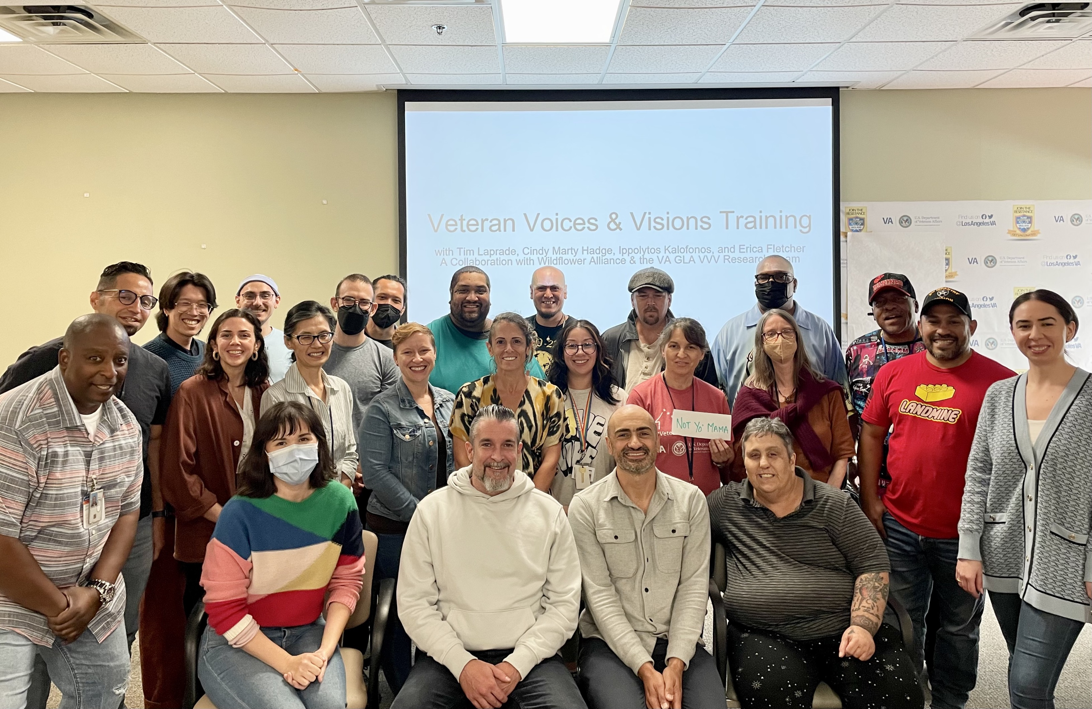
Special acknowledgements: Veterans participating in VVV groups Veterans, VA peers and clinicians on the VVV Facilitation Team
Nev Jones, Susanna Friedlander, Wildflower Alliance, HVN-USA, Cindy Mary Hadge, Tim Laprade, Sera Davidow, Caroline Mazel-Carleton, Mariam Nazinyan, Ron Calderon, Michael Zito, Robert Kern.
Funding from:
VA RR&D SPIRe Award
AHRQ-PCORI Stakeholder-Partnered Implementation Research and Innovation Translation K12 Award
Pilot grants from the VA Research Enhancement Award Program on Enhancing Community Integration for Homeless Veterans
Pilot grant from the VA/UCLA Center of Excellence on Veteran Resilience and Recovery
Contact ikalofonos@mednet.ucla.edu for more information about Veteran Voices & Visions.

Slide 32
Questions?

Slide 33
end

