Slide 1




Some things that I have learned from empirical work on this topic:
Monique Botha
Collective rebellion and resistance: Challenging restrictive ideas of normality

Slide 2
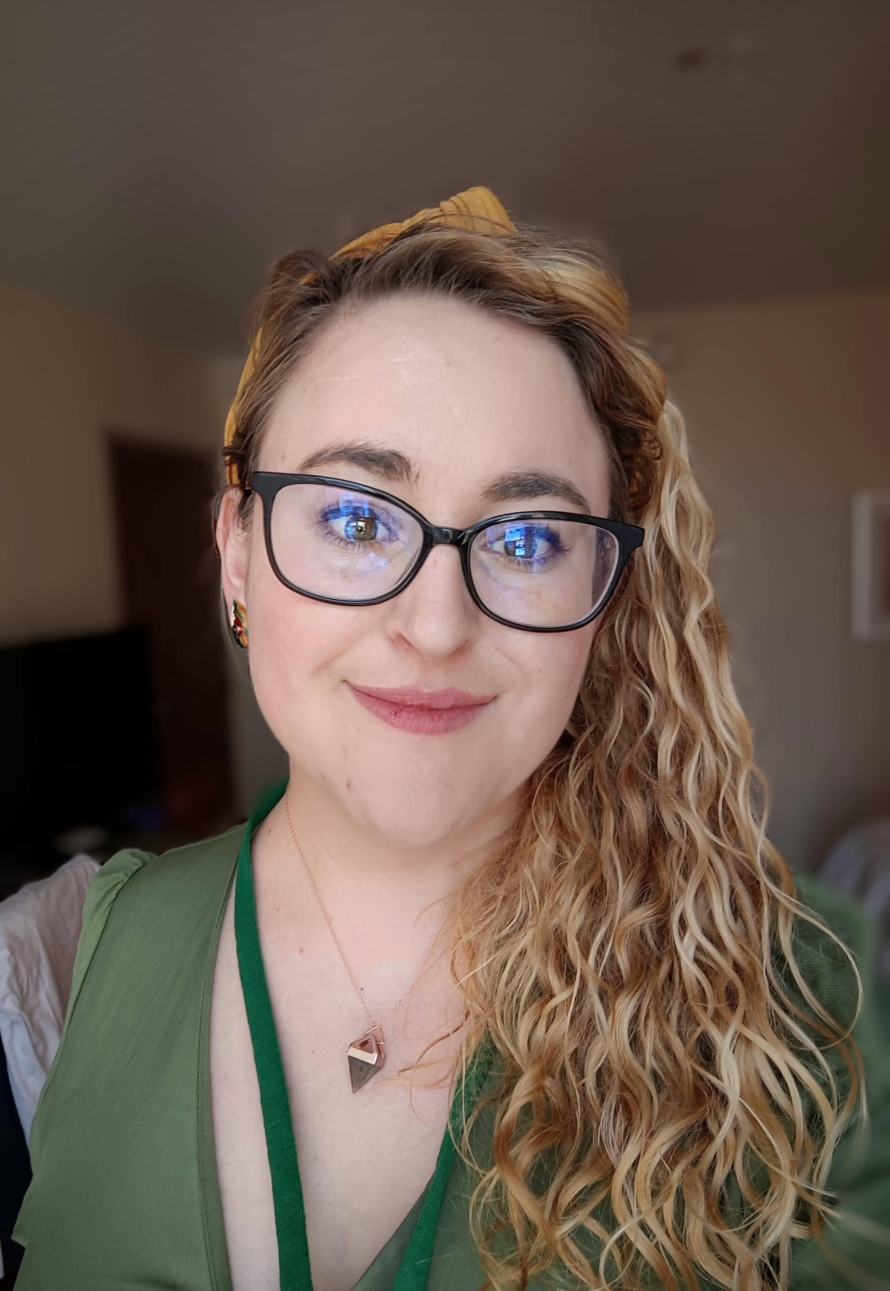
Who am I?
Dr Monique Botha – an autistic and ADHD community psychologist.
Co-founder of CAPTAP
Leverhulme Research Fellow – University of Stirling
Co-I VAHMN intimate partner violence.
Advisor for the Donaldson Trust Scotland
Board member Information Autism
Editorial Board for Autism
Associate Editor for Autism in Adulthood
Co-I for STARTS

Slide 3
What else am I ?
Passionate about:
Neurodiversity
Social justice
Science as a tool for challenging oppression
And books and board games

Slide 4

Neurodiversity
Variations of functioning and experiences of human minds (CIT)
Neurodivergent
Peoples whose cognitive experiences diverge from the norm expected within society (CIT)
Neurominority
People who are neurodivergent, and are marginalized within a society which demands people fit within a normative functioning (CIT)

Slide 5
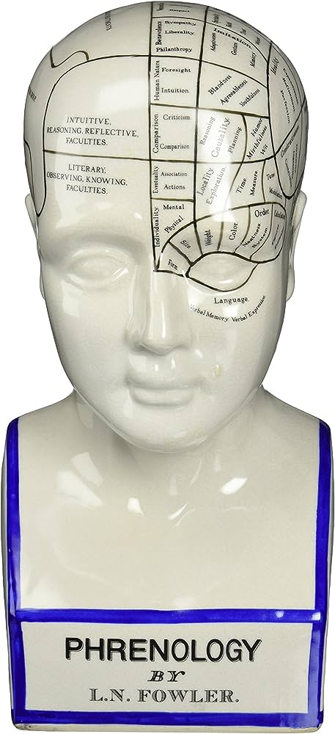
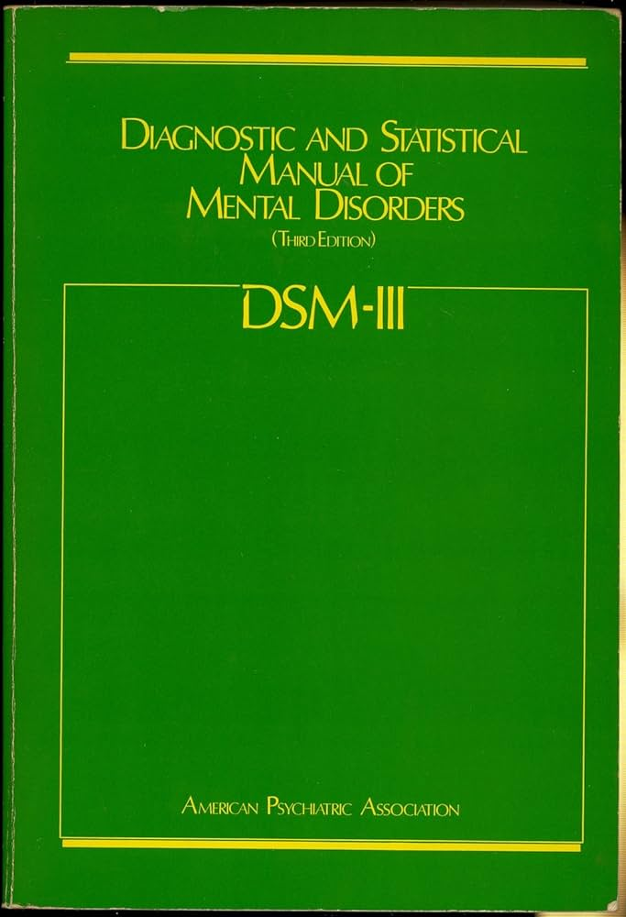
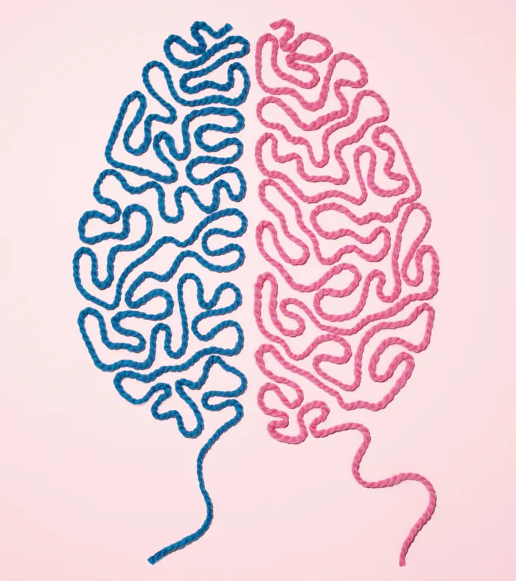
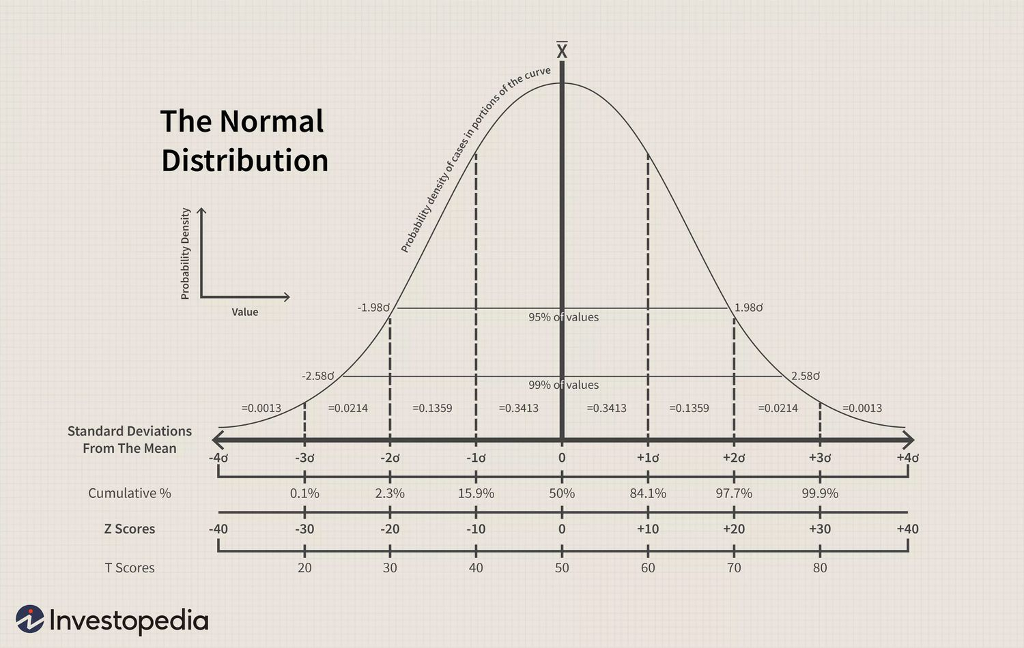
Psychology and a brutal history of normalisation:
I am a psychologist… reluctantly!
Pathologisation of sexual minorities
Race science
The bell curve
The myth of gendered brains

Slide 6
You might think these things have nothing in common
A willingness to punish and stigmatize a deviation from what is considered the “norm”
Violent research & attempts at normalization
Movements to depathologize
Activist movements

Slide 7
Psychology and complicity
That intelligence (as narrowly defined and intangible) is genetic and associated with race
That to be average is to be morally right
Creating hierarchies of people
Political systems and will
Psychology
Justified oppressions
Success based on merit
selfishness is natural
Dominance is inevitable
Justifying the status quo as the result of “nature”
Pretending that there is a natural order to people
No social systems have resulted in this status quo – it is a product of nature
Justifying colonialism
Justifying conversion therapy
Justifying Applied behavioural analysis
Justifying lobotomy
Normalizing intervention and violence

Slide 8
About autism: Background
The field of autism research is full of deeply contested issues at its core:
What autism is at a fundamental level (the ontology of autism) (Botha, 2021; Chapman, 2019; Evans, 2013; Nadesan, 2013; Kapp et al., 2013; Milton & Timimi, 2016)
Who can tell you about what autism is, and what source is reliable (epistemology – knowledge creation) (Frith & Happé, 1999; Hens et al., 2019; Milton, 2012; O’Dell et al., 2016)
And where the focus of autism research should be and who should decide where it should be (funding priorities) (Pellicano et al., 2014; Roche et al., 2020)

Slide 9
Autism
Innate disposition or set of characteristics
Stigmatized characteristics which are pathologized
Reduced social power, equity, and health disparities
Sensory sensitivity
Focussed interests
Social bluntness and transparency
Spiky profile of abilities and needs (inc. language)
Categorized as socially deficient, rude, restricted
Lacking in theory of mind
“Lacking empathy” or community or culture
Exposed to “minority stress”
Reduced social, emotional, and physical wellbeing
Early mortality

Slide 10
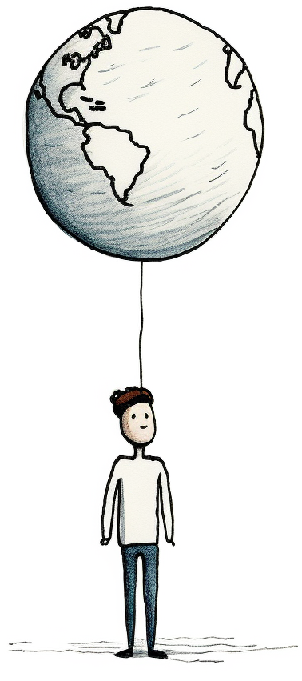
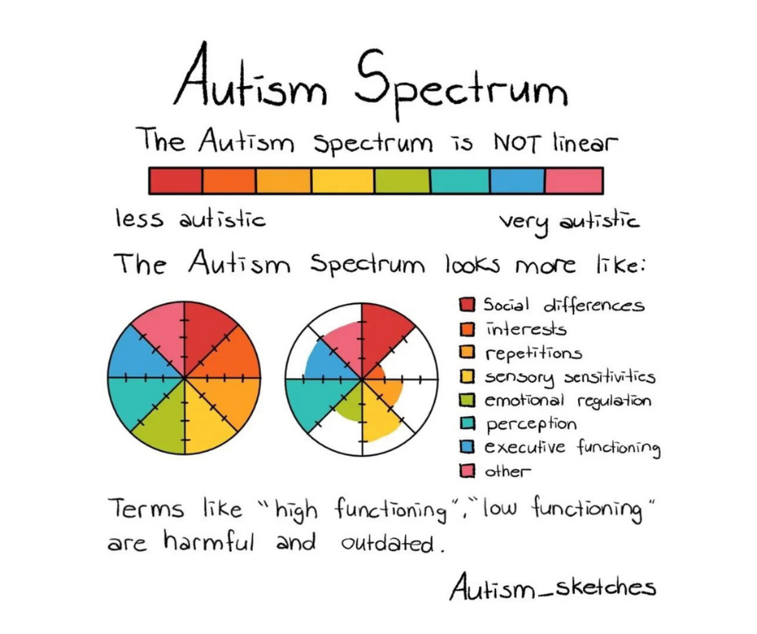
Autism
High functioning:
Ignores struggle, disability, and marginalization
Binary thinking is harmful
Low functioning:
Ignores strengths, boundaries, and self-determination

Slide 11
Why does it really matter how researchers view autistic people?
Controlling the direction, allocation, and use of very large amounts of funding
Creating ideas of autistic people which will be reproduced in society
Creating ideas of autistic people which may strengthen or limit the rights afforded to us.
Science, scientists, and researchers hold immense power

Slide 12
Funding
Published in journals:
The most cited papers are about molecular genetics and other basic sciences (Sweileh, 2016)
Newspaper representations of autistic people are overwhelmingly negative (Karaminis et al, 2022 & 2023)

Slide 13
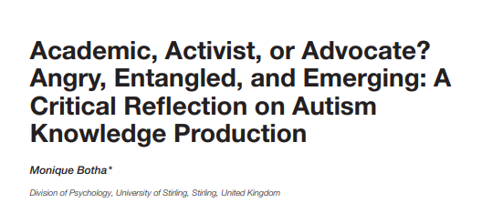

Slide 14
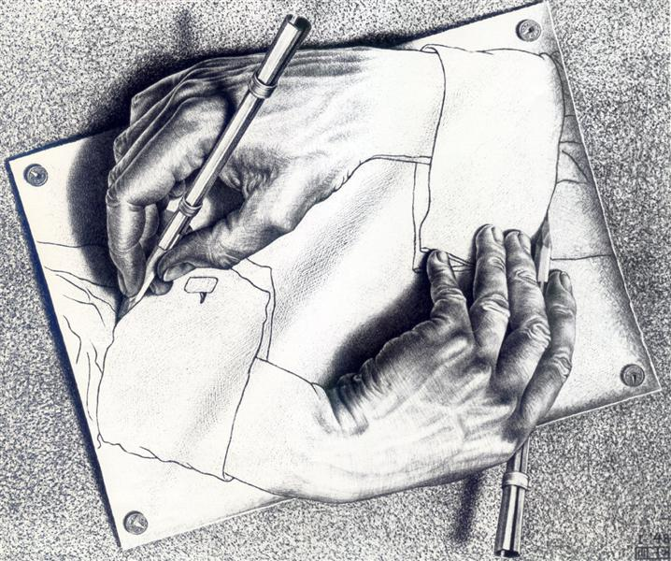
Questions I ask in my critical reflection?
What does it mean to contribute to research as someone who is so readily dehumanized by researchers?
What does it mean to write our own stories? To be believed about our own experiences?
What does it mean to reclaim our lives or combat being talked over? How do you emerge from someone else taking away your voice?

Slide 15
Formative experiences in my early career:
“It is our intention to show that people with ASD exhibit less marked domesticated traits at the morphological, physiological, and behavioral levels… specifically, in adults the abnormal shape of the ears is robustly associated with autistic traits, with higher scores correlating with poorer functioning…” (Benítez-Burraco et al., 2016, p. 1).
My introduction into the literature was through a module “abnormal psychology”.
“In general, it seems that neither apes nor children with autism have—at least not to the same extent as typically developing human children—the motivation or capacity to share things psychologically with others. This means that they both have very limited skills for creating things culturally with other persons” (Tomasello et al., 2005, p. 687).
I memorised the triad of impairment, and the Sally-Ann experiment of “theory of mind”
Encountering a book which argued autistic people were incapable of community (Barnbuam, 2009).
I had person-first language drilled into my brain “to remind people that ‘people with autism’ are human too”.
“Autistic integrity seems more akin to the type of integrity informing environmentalists' familiar demands for consumer and communal responsibility toward non-human animals” (Russell, 2012, pp. 169–170)

Slide 16
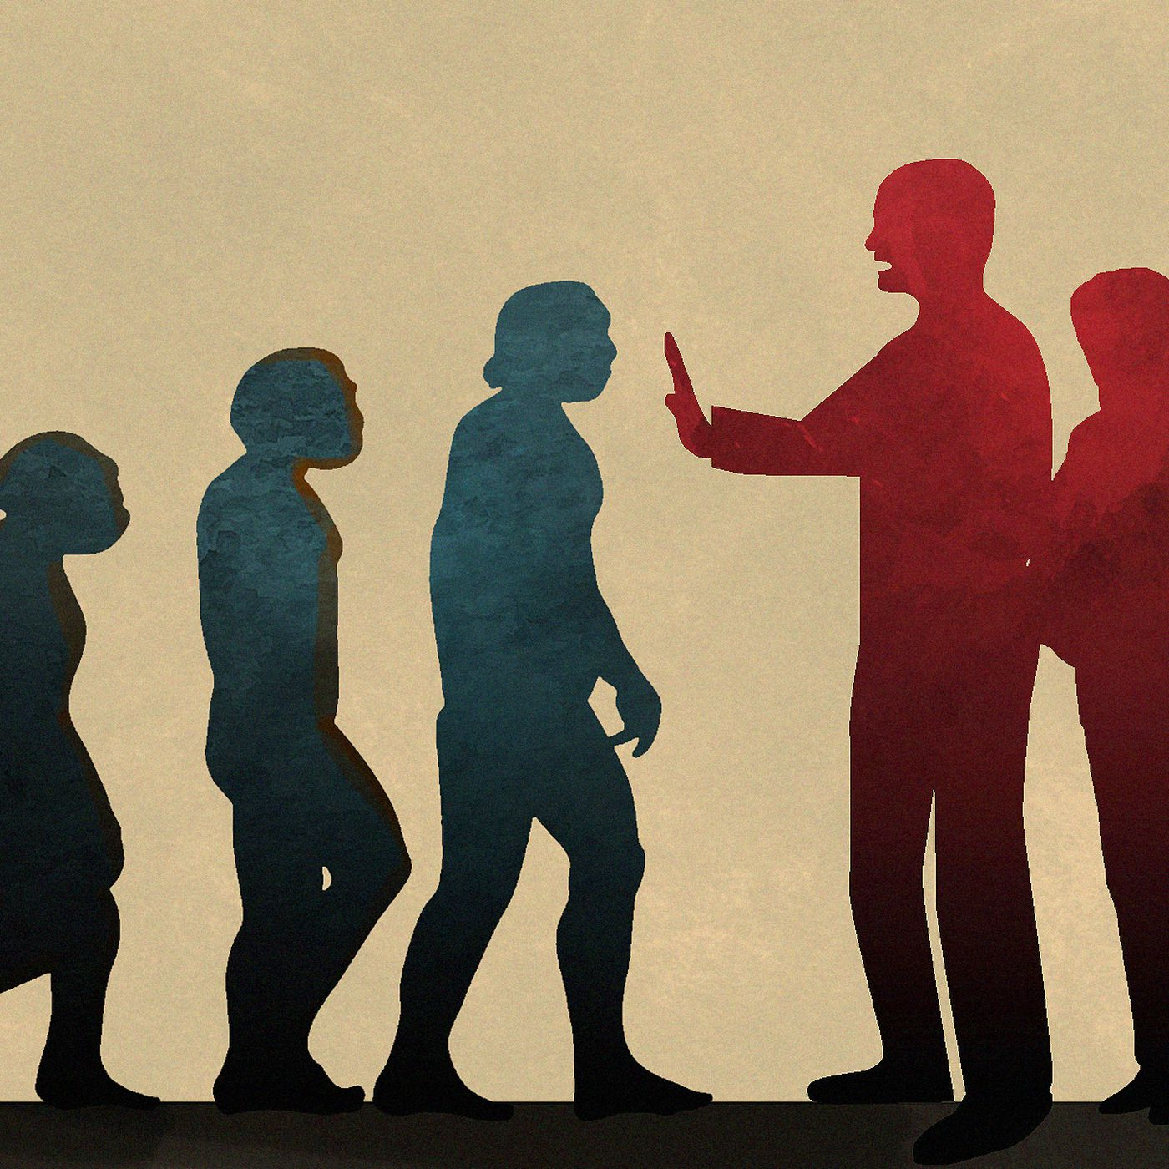
Autistic people are excluded from moral boundaries, personhood, and basic humanness

Slide 17
Dehumanization, objectification, and stigma in autism research:
“Originality is attractive even in the domestic sphere as long as it does not topple over into uncomfortable eccentricity. However, it is only a few people with ASD [autism spectrum disorder] who combine originality with high levels of intelligence and industry who are likely to make a sufficiently sustainable, salient contribution that their absence might be considered unaffordable” (Tantam, 2009, p. 219).

Slide 18
The illusion of objectivity
Failure to separate laws of reality from science from scientists
There might be natural objects or laws to the universe
Scientists who create tools for measuring, which may or may not interfere with laws
Cultural and social norms means science and science communication is socially situated – we present representations

Slide 19

Handling uncertainty
Uncertainty gets distilled into autistic people, and recognized as a feature of science (Hollin, 2018)
When autistic people challenge the gap between how researchers describe autism, and how we experience it we are dismissed as unreliable narrators
This maintains the position of the science, by undermining the position of the community its meant to serve

Slide 20
The Uses of Anger
“I have lived with that anger, ignoring it, feeding upon it, learning to use it before it laid my visions to waste, for most my life. Once I did it in silence, afraid of the weight. My fear of anger taught me nothing. Your fear of that anger will teach you nothing too”.
Audre Lorde

Slide 21
Autistic people are the caretakers of a terrible legacy:
it's good to write our own stories including in science (epistemological justice).
anger, entanglement, and burnout
exposure to these things has harm – double jeopardy
How do we create change sustainably despite hostility?

Slide 22
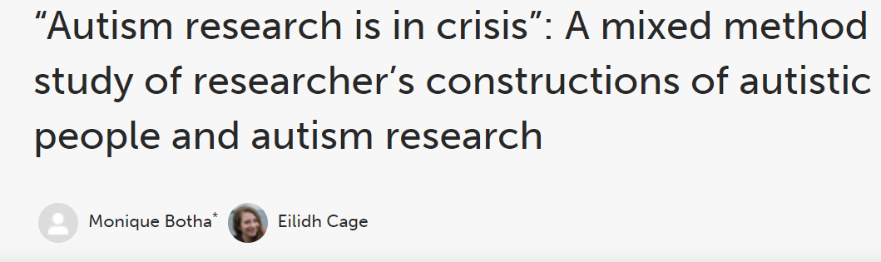



Slide 23
Coding for quantitative analysis:
Orientation quotes:
Narrative | Exemplar quote
Medical model (55.8%; n =96) | “Impairments in social communication with stereotyped and repetitive behaviors beginning early in development. It has a highly variable manifestation, with some individuals nonverbal and lacking self-care capacity, and others able to function extremely well.”
Social model (11.6%; n = 20) | “Growing up autistic […] attracts stigma and stress to the individual and also their family. This is because of prejudice, intolerance and lack of reasonable accommodations”
Neutral embodiment (32.6%; n = 56) | “A neurodevelopmental difference that impacts my social and sensory world.”… “Autism is part of a constellation of ways of being”

Slide 24
Coding for quantitative analysis:
Representative and interesting quotes (coding is going to be slow!)
Broad narratives: Medical vs social model
What makes a cue dehumanizing or stigmatising?
60% of accounts had these cues
Cue types | Definitions | Exemplar quotes
Dehumanisation (Haslam 2006) | Denial of full humanness, infantilisation, compared to non-human animals, treated as lacking in rationality, refinement, culture, passive, or fungible, machine-like comparisons | “autism people may demonstrate an apparent absence of empathy for people's feelings, lack of responsiveness, awareness of social cues or cultural norms”.
Objectification (LaCroix & Pratto, 2015) | Instrumentality, denial of autonomy, inertness, violability, ownership, denial of subjectivity, or fungibility | “Without often comorbid intellectual disability, and dependent upon the severity of their autism, they are interesting, often charming, and valuable members of the community.”
Stigmatising | Strongly stereotyping, risk-based language, strong othering based on normative expectations | “shut down from the outside world; rigid; emotional; fat”

Slide 25
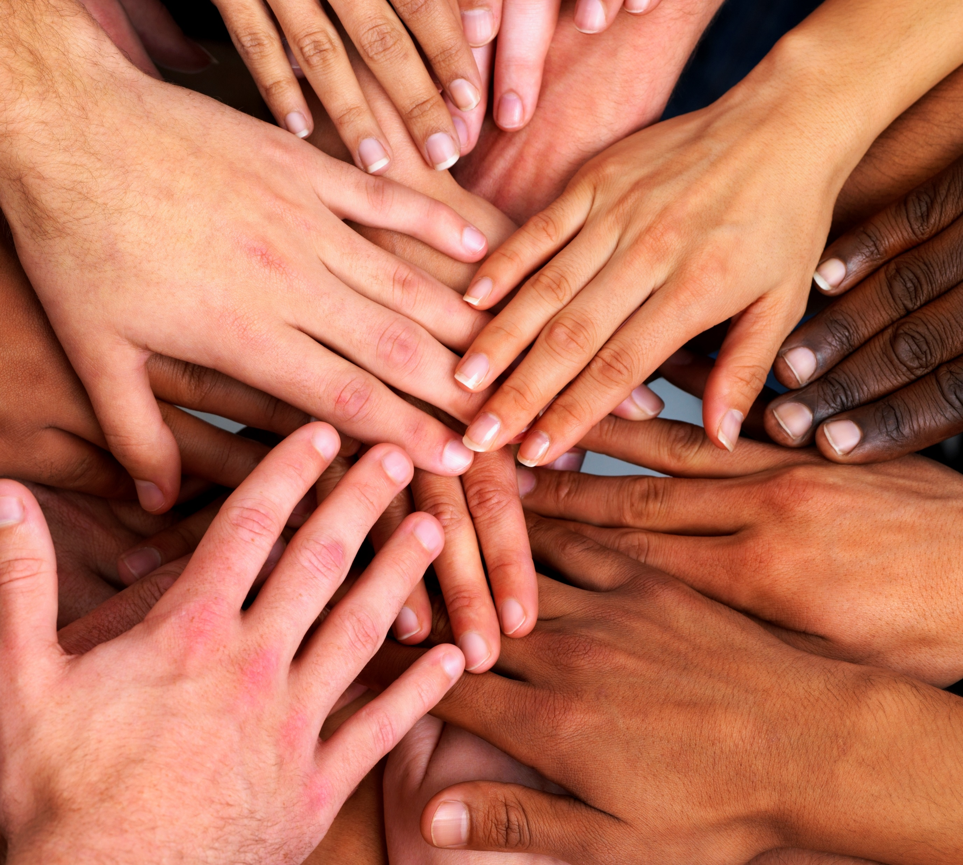
Results:
Taking a social model or neutral embodiment approach relates to a lower odds of stigmatizing and dehumanizing autistic people.
Working to a higher degree with autistic people relates to a lower odds of stigmatizing or dehumanizing autistic people (while controlling for familial connecctions).
Does connection to autistic people make it harder to dehumanize us?
Well… non-familial connection, potentially

Slide 26
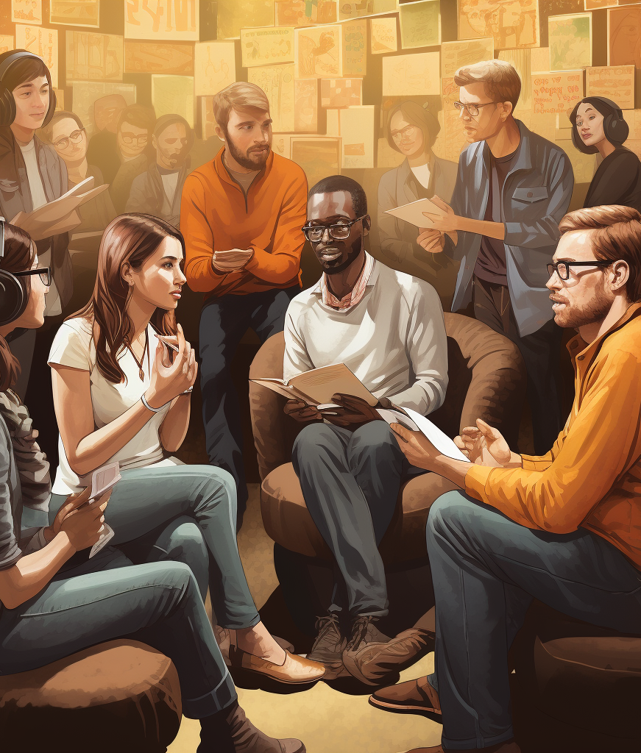
Power sharing
Sharing professional power works… but it isn’t straight forward
People who see autistic people as valuable, and human could be more likely to work with autistic people
Or the more you work with autistic people, the harder it is to dehumanize us

Slide 27
Qualitative results:
Qualitative themes:
The concept of autism is an ideological battle ground
What causes autism is complicated, but what doesn’t isn’t
Quality of life is a fluffy concept until you get to the nitty gritty
The current concept of autism and research are not fit for purpose
Ableism: On the denial of subjectivity, identity, and epistemic authority
Eugenics: Social value and why this all matters

Slide 28
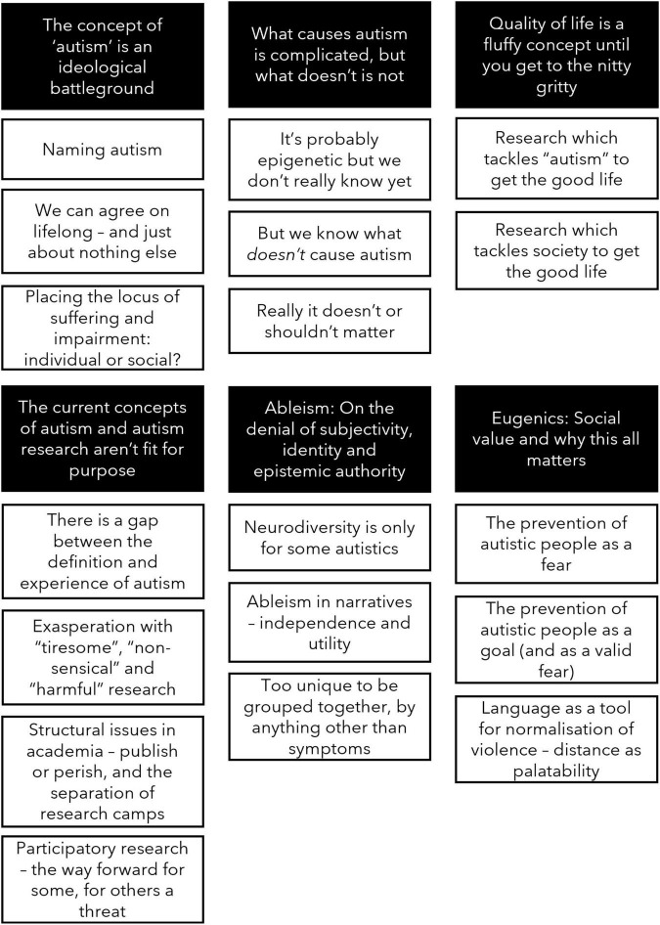
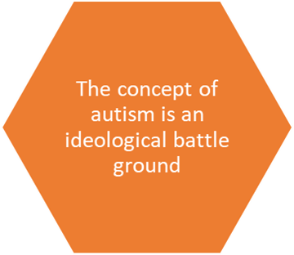
“Autism is neurodevelopmental disorder characterized by a wide array of social/communication deficits, repetitive and restricted behaviors, accompanied by a series of comorbid conditions. It may severely impair the life of the affected subject, as well as that of her/his relatives”
“It is the society we live in, the lack of support available and the ableist and heavily gendered expectations that exist which affect autistic people on a daily basis and lead to autism being described so negatively, even by other researchers”.

Slide 29
Defining autism and why it matters:
The narratives which tended towards disorder and disease:
autism as exclusively within an individual – yet made the individual amorphous (referring to autism, not an autistic person)
suffering and impairment almost exclusively within autism
– and then radiates that suffering out to those around autistic people:
The narratives which tended toward disability, neurodiversity, neurominority:
Stressed the human-ness of the autistic person, often placed autism inside of an individual (as genetic, identity, status)
BUT
Placed impairment, suffering, and disablement primarily outside of the body or person and into society/ environment/ culture

Slide 30
“Autism research should [understand] the genetics of autism-associated neurodevelopment. This may ultimately lead to screening, genetic counselling of parents, and potentially, prevention…. Researching the collateral benefits of treatment for individuals with autism and their families and other relevant persons”.
Quality of life is a fluffy concept until you get to the nitty gritty
“The injustices prevalent in society are where research can make a difference”.
“Therefore, we should seek to involve autistic people in planning and carrying out autism research. To impact quality of life, research should consider interventions addressing socially valid outcomes for autistic individuals, as well as societal attitudes and acceptance and systems of support”.

Slide 31
“I think the main goal should be to understand what causes autism and what also impacts the trajectory of autism for individuals over their lives. By understanding the former we may be able to intervene for parents before they have a child”
Eugenics: Social value and why this all matters
“Without often comorbid intellectual disability, and dependent upon the severity of their autism, they are interesting, often charming, and valuable members of the community”
“Autism research should pursue multiple goals: Understanding the genetics of autism-associated neurodevelopment. This may ultimately lead to screening, genetic counselling of parents, and potentially, prevention”.

Slide 32
Autistic revolution and revolt
Critical autism studies
Critical Neurodiversity Studies (Shout out to Dr Robert Chapman for being potentially the first assistant professor of critical neurodiversity studies)
Critical tradition:
Double empathy problem (Milton, 2012) – now spawning an entire empirical field of interaction studies
Neurodivergent epistemologies – diversifying how we conceptualise knowledge creation
Social justice for neurodivergent people – more and more projects about centring autistic people, quality of life, and social justice

Slide 33
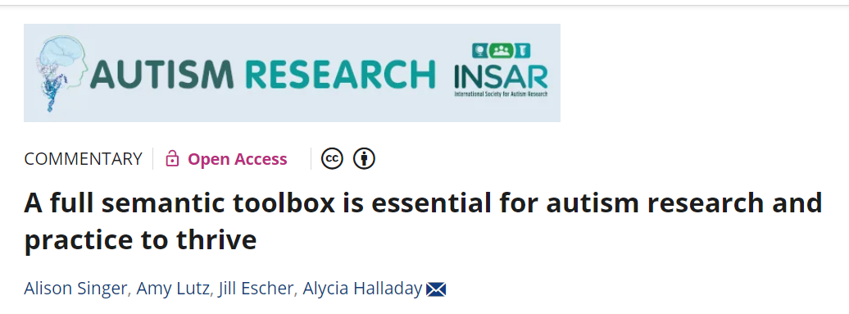
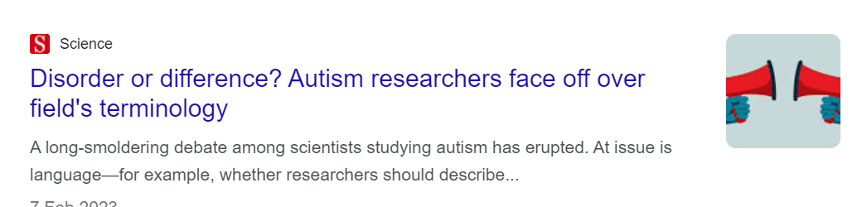
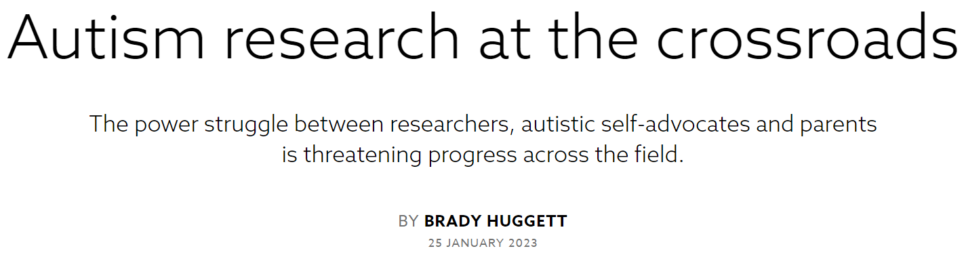

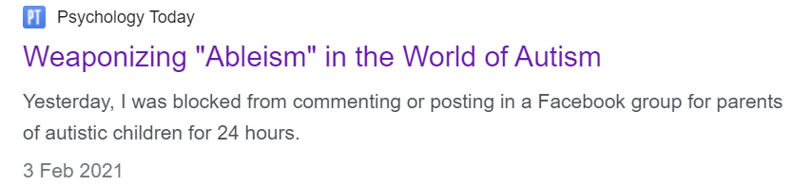
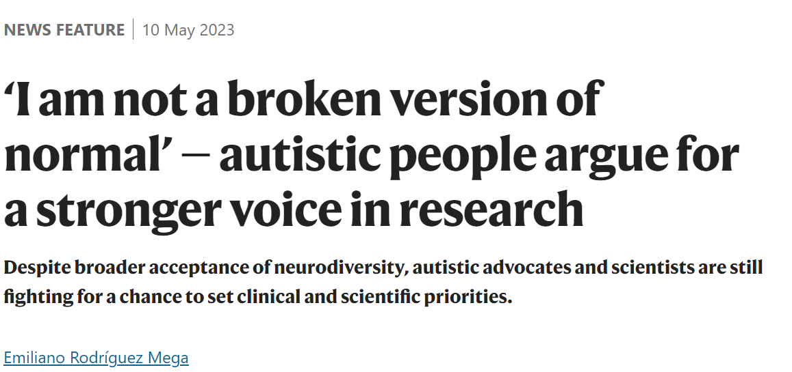
Autistic people are positioned as antagonists against parents of autistic children, researchers, and “progress”

Slide 34
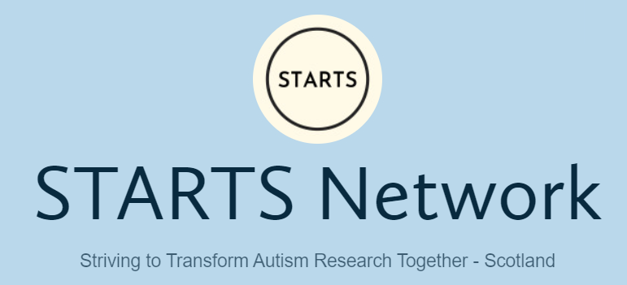
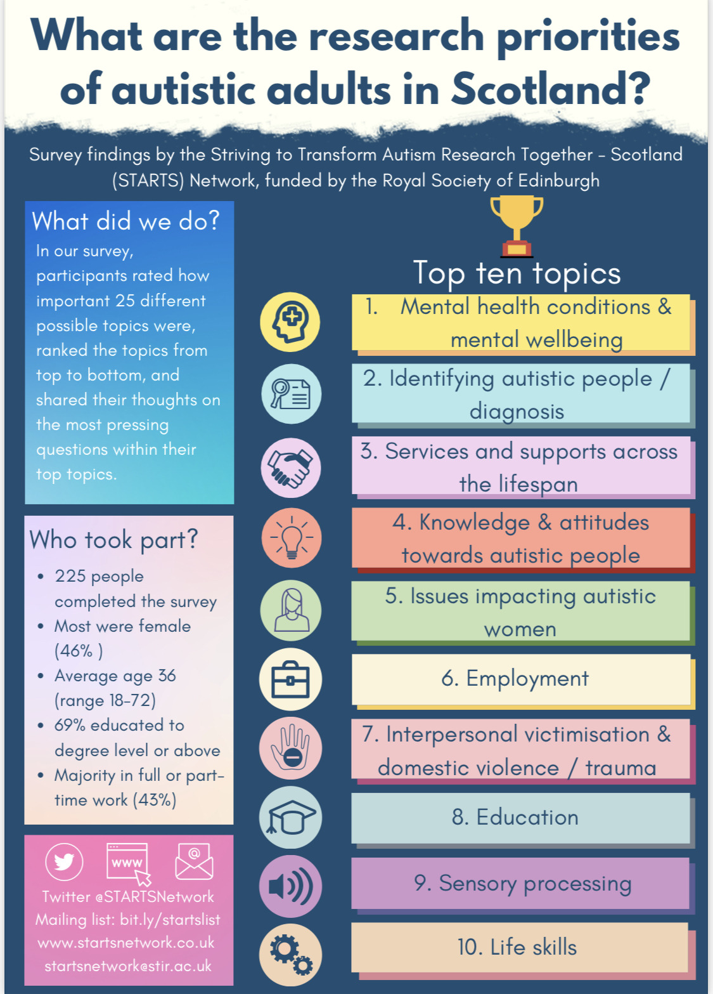
Academic Team:
Dr Eilidh Cage
Dr Monique Botha
Dr Catherine Crompton
Sarah Dantas
Khiah Strachan
Advisory team:
Aaron Gallagher
Mark Robinson
Rachel Birch
Charlie MacKenzie-Nash
Stasa Morgan-Appel
https://startsnetwork.co.uk/

Slide 35
The future of autism research is… community psychology
Research as a tool for liberation from unequal society
Led by own communities and allies
To create sustainable social change

Slide 36
Imagined futures
Listened to
Inclusive practice
Tackling research violence
We are talking and listened to and not only talked about
Community led means creating avenues to participate for everyone – not just the token
Dehumanization is not the status quo – we can talk about struggle or disability or pain, without revert to creating hierarchies

Slide 37
What is the metric for this?
Rigor
Transparency in collection and use of data
Meaning –subversive impact
Has meaning, utility, and impact for autistic people and the society we experience
Ethical responsibility
Responsibility for product AND use of research (inc in media)
Power-sharing
Genuine power-sharing
Robust methods – triangulation
Responsibility for harm to colleagues participants, co-producers, and consumers of work
Opportunities for leadership
Ability to lead, to veto, to be heard, & to be named
Challenges status quo
Open science
Free informed consent
Reflexivity

Slide 38
Take home message
Like most minority communities the message is clear:
Stop doing things to us, and start doing them with us

Slide 39
Thank you for listening
And thank you to the funders who give me enough stability to be able to produce this work.
Email: m.d.botha@stir.ac.uk Twitter: @DrMBotha

