Slide 1
Did You Know
Voices can be experienced in the head, in the ears, outside the head, in some other part of the body, or in the environment.
Voices often reflect important aspects of the hearer’s emotional state – emotions that are often unexpressed by the hearer.
Whilst one in three people who hear voices become consumers of mental health services – two in three people can cope well without mental health service provision.
Between 2% and 10% of people across the world hear voices.
Some voices are perceived as friendly, spiritually uplifting, supportive and helpful while others are perceived as being severely intrusive, malevolent, critical, threatening, hostile, and distressing
There have been many famous, successful and influential voice hearers throughout history.
Voices can be male, female, without gender, child, adult, human or non-human.
People may hear one voice or many. Some people report hearing hundreds, although in almost all reported cases, one dominates above the others.
Notes:
Some voices are perceived as friendly, spiritually uplifting, supportive and helpful while others are perceived as being severely intrusive, malevolent, critical, threatening, hostile, and distressing, with some voice hearers feeling powerless to manage them (Chadwick et al; 2000; Delespaul et al; 2002; Sensky et al; 2000; Wykes, 2004).
Voices also vary immensely in terms of their characteristics and content: some sound old, wise, or childlike, they are male and female, they may shout, cry or whisper, some are distinct others are vague, they may compliment, criticise, tease, command, threaten or provide support, guidance, and companionship (Watkins, 2008). There may be one dominant voice, or a few voices and sometimes many, with some being recognisable to the person and others not. The voices might talk to each other, announce everything that is happening, or provide a running commentary describing the voice hearer’s thoughts, feelings, and behaviour. Some people hear their own thoughts spoken out loud by the voices. They may discuss the person or predict the future. Some voices hearers engage in two way or group conversations. They might talk individually or all at the same time. Some voices are perceived to come from inside of the head and others from the surrounding environment (Romme et al; 2009).

Slide 2
Gordon Kay
Hearing Voices Groups
Why you should be running them and How

Slide 3
Hearing Voices
How did I get involved in this work
BH story
My first group (a group of people in forensic hospital in Manchester with no leave)
Notes:
This is the artwork for our flyers and manuals. Credit to Matthew Haycroft for his artwork depicting ‘Old Mate” and his experience of hearing voices.
I worked with the late Brian Hickman – Most of his adult life detained in secure hospital. He appeared to have given up – trapped by fear, rarely left his room, disengaged, hopeless, helpless, overweight , poor outlook for his future.
He got some leave to the local HV group in Manchester, and his life changed. He started to teach me about voices, I went to some of the community meetings and events with him and met other peer leaders.
When he was discharged, they wouldn’t let him back in. A peer support group was not supported at that time, so we had to make it a therapy group. By making our group a CBTp based group it was more acceptable to statutory services (a similar story I have experienced from statutory services in Brisbane)

Slide 4
Why
Just like Brian. Your H/V groups can make a profound difference in peoples lives.
Community groups come and go even in supportive environments like Manchester.
Some people don’t have access to peer support groups.
Working in partnership can breathe life into the NGO/non gov sector.

Slide 5
There appears to be a continuum between good and poor mental health that all voice hearers move up and down ranging from relatively common experiences with little or no impact on people’s lives through to extraordinary experiences that profoundly affect individuals, family, culture, and societies. For those with persistent problems, impairment in functioning can be profound
Profound
Impact
Hopelessness
Fear
Inescapable
Anxiety
Depression
Suicidal behavior
Social Isolation
Substance misuse
Unemployment
Poverty
Homelessness
Single
Demographics our Study n=61
More than 5 admissions n=34
Educated at degree level n=2
Long term unemployed n=56
Married n=1
Source of income, welfare n=59
Serious suicide attempt n=25
Notes:
Voice hearing clearly occurs under many different circumstances ranging from relatively common experiences with little or no impact on people’s lives through to extraordinary experiences that profoundly affect individuals, family, culture, and societies.

Slide 6
Why (a rational for the bureaucrats)
First Line treatment psychotropic medications.
Between 25–60% continue to experience voices despite medication adherence.
Unwanted side effects (sedation, weight gain, sexual disfunction, tremors, stiffness, agitation)
Limited access to the ‘gold standard’ therapy CBTp
Strong evidence base for group-based CBT for voices
Notes:
LIMITATIONS OF CURRENT TREATMENT
Since the late1950s psychotropic medications are the first line treatment that are used by psychiatrists to treat patient’s auditory hallucinations.
Between 25–60% continue to experience them despite medication adherence (Garety, Fowler, & Kuipers, 2000; Morrison, 2001; Sensky, et al., 2000; Tarrier & Wykes, 2004)
For many people negative side effects, such as sedation, weight gain and associated metabolic problems, have been reported to outweigh the benefits of medication (Asher-Svanum et al., 2010; Kalhovde et al., 2014) and as many as three quarters of patients with schizophrenia discontinued their drugs over 18 months (Lieberman et al., 2005).
There are a number of meta-analyses that demonstrate the benefits of individual CBTp (Gould, Mueser, Bolton, Mays, & Goff, 2001; Jauhar et al., 2014; Pfammatter, 2011; Pilling et al., 2002; Wykes, Steel, Everitt, & Tarrier, 2008; Zimmerman, Favrod, Trieu, & Pomini, 2005).
It is estimated that only one in 10 people in the UK who might benefit from CBTp are getting access to treatment (Brophy 2017). Access and availability to treatment remains poor for consumers (Berry & Haddock, 2008).
CBTp has been extensively evaluated and there is robust evidence for its positive impact, notably on the reduction of distress when hearing voices (van der Gaag et al., 2014).
Few voice hearers have access to this therapy. Factors that impact on the level of access and availability to CBTp include limited resources and problems with the postgraduate formal training and expert supervision of skilled CBTp therapists (Ince et al., 2015). Organisational barriers to implementing CBTp such as limited resources, conflicts between service priorities, an emphasis in services on monitoring mental health rather than intervening, and problems with the training and supervision of skilled CBTp therapists means that access and availability to treatment remains poor for consumers (Berry & Haddock, 2008)
Emerging Evidence
Wykes, Steel, Everitt, and Tarrier (2008), conducted a meta-analysis of 34 quantitative studies which explored the efficacy of group-based CBTp. Overall, the researchers found that group-based CBTp had a beneficial effect on positive symptoms (e.g., delusions, hallucinations, and disordered speech). Furthermore some studies are suggesting group based CBTp is associated with even better outcomes for consumers when compared to individual treatment, such as lower levels of depression or distress, a reduction in overall symptoms, increased perceptions of control over voices, reduced negative beliefs about voices and their power, greater use of coping strategies, higher self-esteem, and improved social functioning (Chadwick et al., 2000; Gledhill, Lobban, & Sellwood, 1998; Pinkham et al., 2004; Wykes et al., 1999). But other trials have not found this effect (Baraclough et al., 2006, Penn et al., 2009, Wykes et al., 2005).
Furthermore, some researchers have found that group therapy specifically for auditory hallucinations is effective in helping people manage their distress even when antipsychotic medications have failed (Ruddle, Mason, & Wykes, 2011), and to be more effective than treatment as usual or supportive therapy (Barrowclough et al., 2006; Bechdolf et al., 2010; Lecomte, Leclerc, & Wykes, 2012; Penn et al., 2009; Peters et al., 2010; Wykes, Steel, Everitt, & Tarrier, 2008).

Slide 7
How (Combination of CBT/HVN Values)
Group work
10 sessions
2 facilitators, peer workers working with clinicians
4-8 participants
A safe non-judgemental space to share experiences
Normalisation
Coping strategy enhancement
Formulation/construct
Influencing Beliefs
Acceptance and engagement
Compassion for voices
Mindfulness
Notes:
Kay and Kendall (2017) explored the synergy and difference of the two approaches.
The Coping with Voices program relies on knowledge and values created within the hearing voices movement and consciously attempts to combine them with evidence-based practice from the CBTp literature.
By combining these two areas of research, the we developed a low intensity 10 session group-based manualised intervention for distressing voices.
Quantitative evidence from the CBTp based literature suggests that beliefs about voices (Birchwood and Chadwick 1994; 1995; 1997) and coping strategy enhancement (Tarrier et al.,1993; Wykes et al., 1999; Lecomte et al 2008) may be key targets for group intervention, but other factors such as self-esteem and social activity may also be relevant (Wykes et al., 2005; Barrowclough et al. 2006).
Whereas the qualitative evidence from the HVN indicates that connecting voice hearers with each other significantly reduced social isolation (Romme & Escher, 1989) and that voice hearers most value having a safe space to share their experiences and to feel ‘normal’ (Corstens et al., 2014).

Slide 8
How
Convince your organisation
Run a pilot and collect some data
Train your workers
Read about how we did it (rational, training, implementation and results)
Notes:
Publications
Kay, G., Slattery, M., & Kendall, E. (2021). The facilitators’ perspectives of delivering a ‘Coping with Voices’ group (Part 1). Psychosis, 1-11.
Kay, G., Kendall, E., Slattery, M., Scott, J., Gore-Jones, V., & Dark, F. (2021). Results from a quasi-controlled trial of a “Coping with Voices” group. Part 2. Psychosis, 1-11.
Twenty-two staff were recruited as facilitators via an expression of interest. None of the facilitators were formally qualified in CBTp but were experts in delivering therapies such as ACT and CBT and have important links with the HVN. Facilitators came from a range of backgrounds including two peer support workers, two consultant psychiatrists, three social workers, one neuropsychologist, nine psychologists, two occupational therapists and three nurses. Facilitators attended 10 days of inhouse psycho-social intervention training and 3 days of workshops with Peter Bullimore (an “expert by experience” and leading trainer in working with voice hearers). The in-house training focussed on the relationship between hearing voices, stress and trauma, and explored cognitive and behavioural strategies and techniques for managing distressing voices. Peter Bullimore’s workshops are grounded on the acceptance of lived experience of voice hearing and facilitators learned new skills to enable them to successfully engage with HVN values. Facilitators were taught the Maastricht Interview (Corstens et al., 2008), as a way of more fully exploring the experience of voice hearing. All of the facilitators attended monthly group-based peer supervision facilitated voluntarily on a rotation by four of the more experienced facilitators. When delivering the program, the more experienced facilitators were paired with less experienced facilitators as it was important to build the skills and confidence and ensure that the key components of CBTp and the values of HVN were upheld. Given the training, supervision, content and focus of Coping with Voices these facilitators would appear to have the ideal combination of expertise

Slide 9
How
Flyers and posters
Meet People before group
A safe space where people will feel welcome and comfortable
Exploratory
Voices are welcome, we are not trying to get rid of them
Bring a sense of fun
Coffee and cake, music, poetry

Slide 10
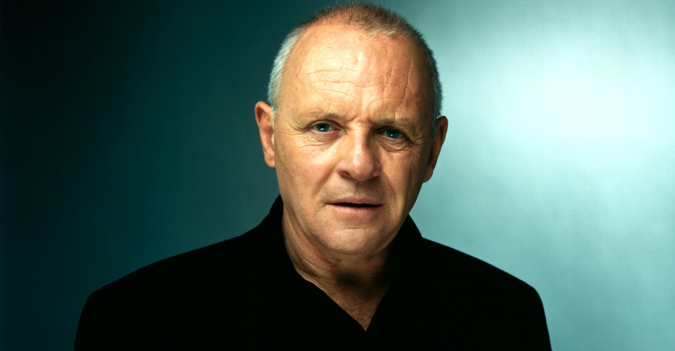
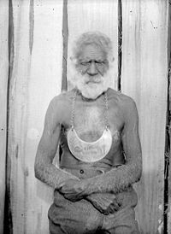
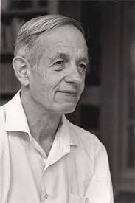
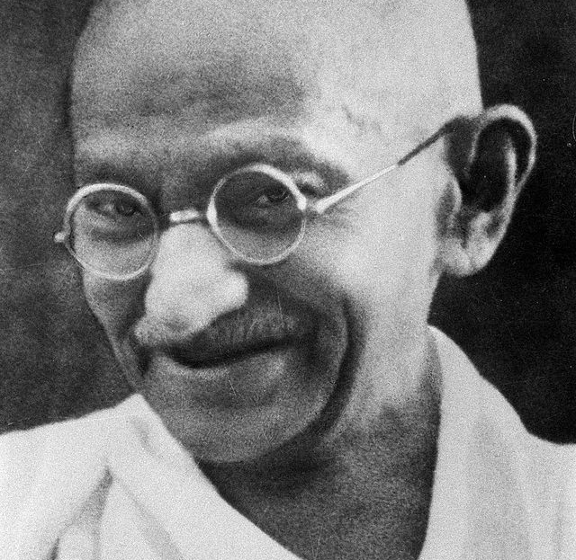

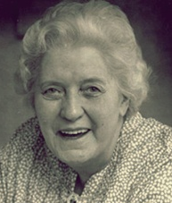
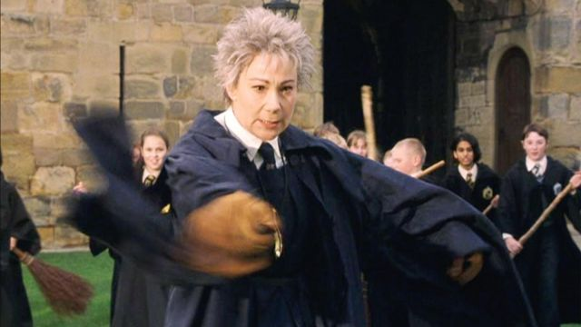


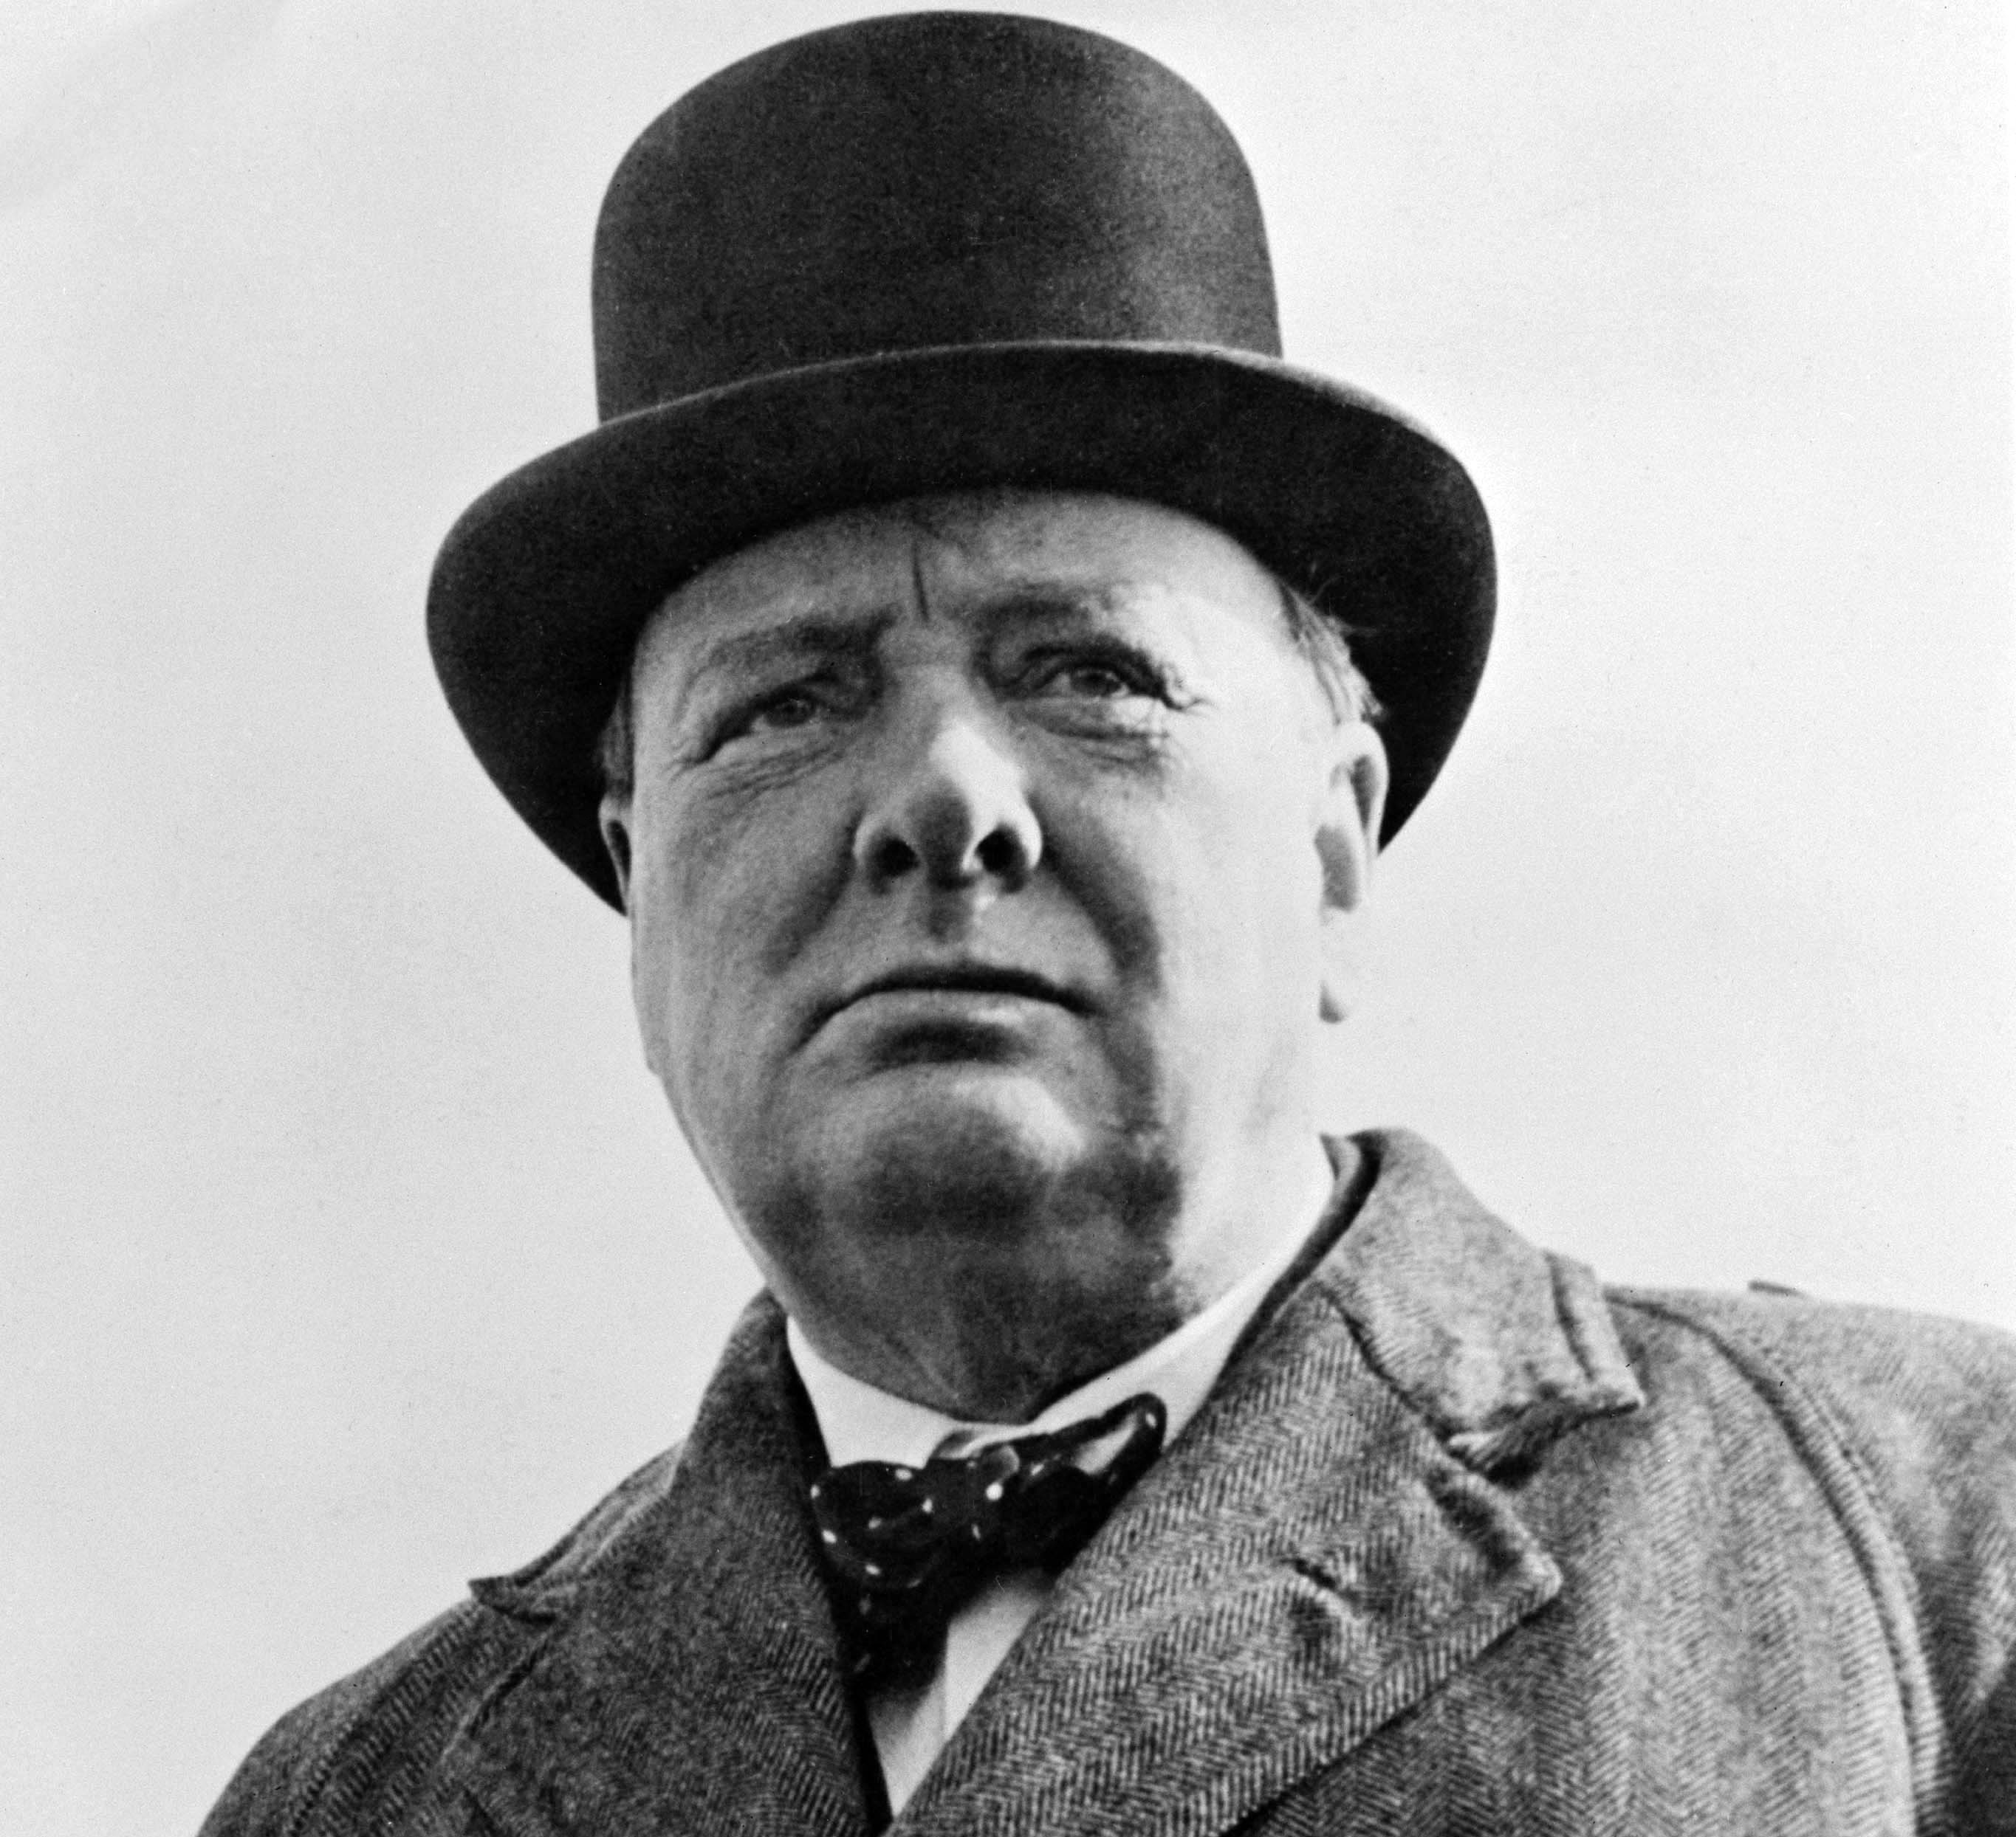


Normalisation – Famous faces
Notes:
This component is heavily influenced by materials from the peer-led HVN approach and is concentrated within the first half of the ten-week programme.
It introduces ideas such as the 'expert by experience’ to empower voice hearers. Unlike in the clinical context, hearing voices is framed as an extension of normal experience (Corstens et al., 2014; Romme & Escher, 2000). Group facilitators may provide examples of their own experience of hearing voices or other unusual experiences, which facilitates engagement and rapport building. Strategies included in the sessions are highlighting the way in which voices make sense and/or have meaning within the context of a person’s life history, discussing the prevalence of voice hearing in the general population, the origins of voices from different perspectives, and the conditions under which all people are likely to experience voices from relatively common experiences with little or no impact on people’s lives through to extraordinary experiences that profoundly affect individuals, family, culture and societies. Famous, successful, and influential voice hearers are identified and discussed along with inspiring stories from other ‘every day’ voice hearers. The experience of emotional distress associated with hearing voices is reframed as being both normal and understandable. The purpose of this component is mainly to empower clients and enable them to develop feelings of self-worth partly by normalising, to a certain extent, their experience of hearing voices.
Umbarra, or King Merriman (died 1904) was an Aboriginal elder of the Djirringanj/Yuin people of the Bermagui area on the South Coast of New South Wales.
Although Aboriginal people traditionally did not have kings or chiefs, only elders, the white colonial powers used to often grant king plates to certain elders, hence the moniker King.
He lived on , in the middle of Wallaga Lake, while his people lived on the shores of the lake. Umbarra was believed to have clairvoyant abilities, and communicated with a black duck, his moojingarl, which forewarned him of forthcoming dangers.
ST Joan Of Arc
It was at the age of thirteen and a half, in the summer of 1425, that Joan first became conscious her “voices” or her “counsel.” It was at first a voice, as if someone had spoken quite close to her, but it seems also clear that a blaze of light accompanied it, and that later on she clearly discerned in some way the appearance of those who spoke to her, recognizing them individually as St. Michael (who was accompanied by other angels), St. Margaret, St. Catherine, and others.

Slide 11
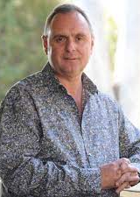
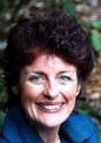

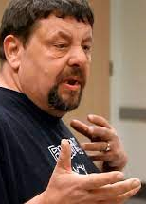

Formulation/Construct
Notes:
Watch TED talks and You Tube films, identify similarities and differences, start to explore. How did they break the cycle and become world leaders
Start telling your story. Acceptance and engagement.

Slide 12
Normalisation - Stress Vulnerability Model
Examples:
Bills
Relationships
Work stressors
Illness
Drugs
Sleep deprivation
Social isolation
Unemployment
Homelessness
Bereavement
Any big changes (e.g. moving, marrying, divorce)
Person 2 has lots of pre-existing vulnerabilities, so it wouldn’t take as much external stress for them to stop coping
Person 1 has few or no pre-existing vulnerabilities, so it would take a lot of external stress for them to stop coping
Notes:
Person A
Touching the Void: In 1985 Joe Simpson climbed the west face of the 21,000-foot Siula Grande in the Peruvian Andes, Simpson dropped over a 150-foot cliff, into an icy crevasse. For four days he was alone in the dark, seriously injured in shattering pain, frost-bitten and dangerously dehydrated, he started to hear voices. The voice inside his head ordered him forward like an impatient sergeant, even when what he calls his "mind" was lost in delirium. Perhaps worst of all, he was tormented by the Boney M song, Brown Girl in the Ring, which began playing in his head and wouldn't stop. As he notes with distaste "I thought, 'Bloody hell, I'm not going to die to Boney M.'."

Slide 13
Circumstances in which voices can be heard Draw up a continuum Explore the differences between those who cope and those who don't
Bereavement and mourning
Poor Sleep
Being isolated
Traumatic Life events
Substance misuse
Stressful environments
Physical health
Spirituality and culture
Torture
Hypnagogic
Hypnopompic
Imaginary companions of childhood
Hypnotic experiences
Near death experiences
Psychedelic experiences
The call of vocation
Sensory deprivation
Notes:
More Normalisation
Hypnagogic- going to sleep-just dropping off. Several studies suggest around 70% prevalence. Calling your name most common.
Hypnopompic-waking up.
Imaginary companions of childhood, most prevalent in preschool years. Singer (1973)found that from a study of 141, 3&4 Yr Olds 65% reported such playmates. Most cases-they usually disappear after a year or two. For other they stay through out life. In many instances the children described actually hearing the voice of their imaginary playmate.
Bereavement and mourning a study of 50 bereaved people 82% felt a presence. 30% told of hearing the voice of the deceased person. Of those who heard the voices this continued long term 12 months=52%, 10 years=52%, 20 years=42% (Grimby 1993)
Near death experiences- Whilst travelling towards the light many describe being Stopped and told to go back
Psychedelic experiences-Lsd-magic mushrooms-predominantly visual in nature-sounds voices and music can also occur.
In some cultures naturally occurring psychedelic substances are used in context fo shamanic practices in order to cntact what is believed to be the spirit world.
The call of vocation-profoundly spiritual experience-many describe an inner voice.
Also medical disorders, fever, side effects from prescribed medicines, tumours, epilepsy, other neurological disorders
Examples- polar explorers, mountain climbers, astronauts, lone or shipwrecked sailors, submarine crews, prisoners in solitary confinement have all described having a range of hallucinatory experiences during their lonely and stressful ordeals.
When Felicity Aston started smelling fish and chips, she knew something was wrong. The unmistakable aroma of the classic British pub food, deep-fried fish and french fries, could only mean one thing: She must be hallucinating. After all, there are no pubs in the middle of Antarctica. The British explorer was skiing solo across the great frozen continent and had not seen another human being for weeks. "It drove me insane," said Aston. "It was like I was skiing along a huge row of fish and chips shops, the whole day.“During the polar summer, the sun circles in the sky, never going down. It became Aston's constant companion and she began greeting it in the morning. "This developed into me having full-blown conversations with the sun in my mind," she added.

Slide 14
Most People Cope well Even those with Nonclinical explanations Beliefs about voices seems important
Voice hearers who cope well
Spirit guides
Deceased ancestors (Native American psychiatrist, dream time)
The voice of God
Inner speech
Invisible companions
Benevolent intentions
Acceptance and engagement
My own experience
Peer support
Voice hearers who don’t cope well
Possesion Demons/Gin/Devil
Persecutors such as mafia, aliens, the underworld
Malevolent intentions
Omnipresent powerful voices
Distraction and avoidance
Isolation
Beliefs about origins, power, choice and control
Notes:
There is a wide variety of non-clinical explanations that have been used to refer to voices with no physical cause, including spirit guides, angels, demons, ghosts, alternative dimensions, deceased ancestors, the voice of God, inner speech, the voice of the devil, divine intervention, channelling, or invisible companions
BAV Professor Max Birchwood and Professor Paul Chadwick Groundbreaking research.
One factor that has been linked to these poor outcomes is the extent to which the voices are considered powerful. Birchwood and Chadwick (1997) found that more than two thirds of voice hearers diagnosed with schizophrenia were depressed and this was attributable to their beliefs of entrapment and the power of the voice. More than 85% of voice hearers diagnosed with schizophrenia regarded their voices as powerful and omnipotent, making them feel weak and dependant and unable to have any escape from the voices or control. Trower et al. (2004), found that 85% of voice hearers perceived their voices as powerful and themselves as weak, thus feeling unable to achieve control over their voices, whilst Beck-Sandler et al., (1997) found the greater the perceived power and omnipotence of the voice compared to the voice hearer the more likely the voice hearer will follow commands.

Slide 15
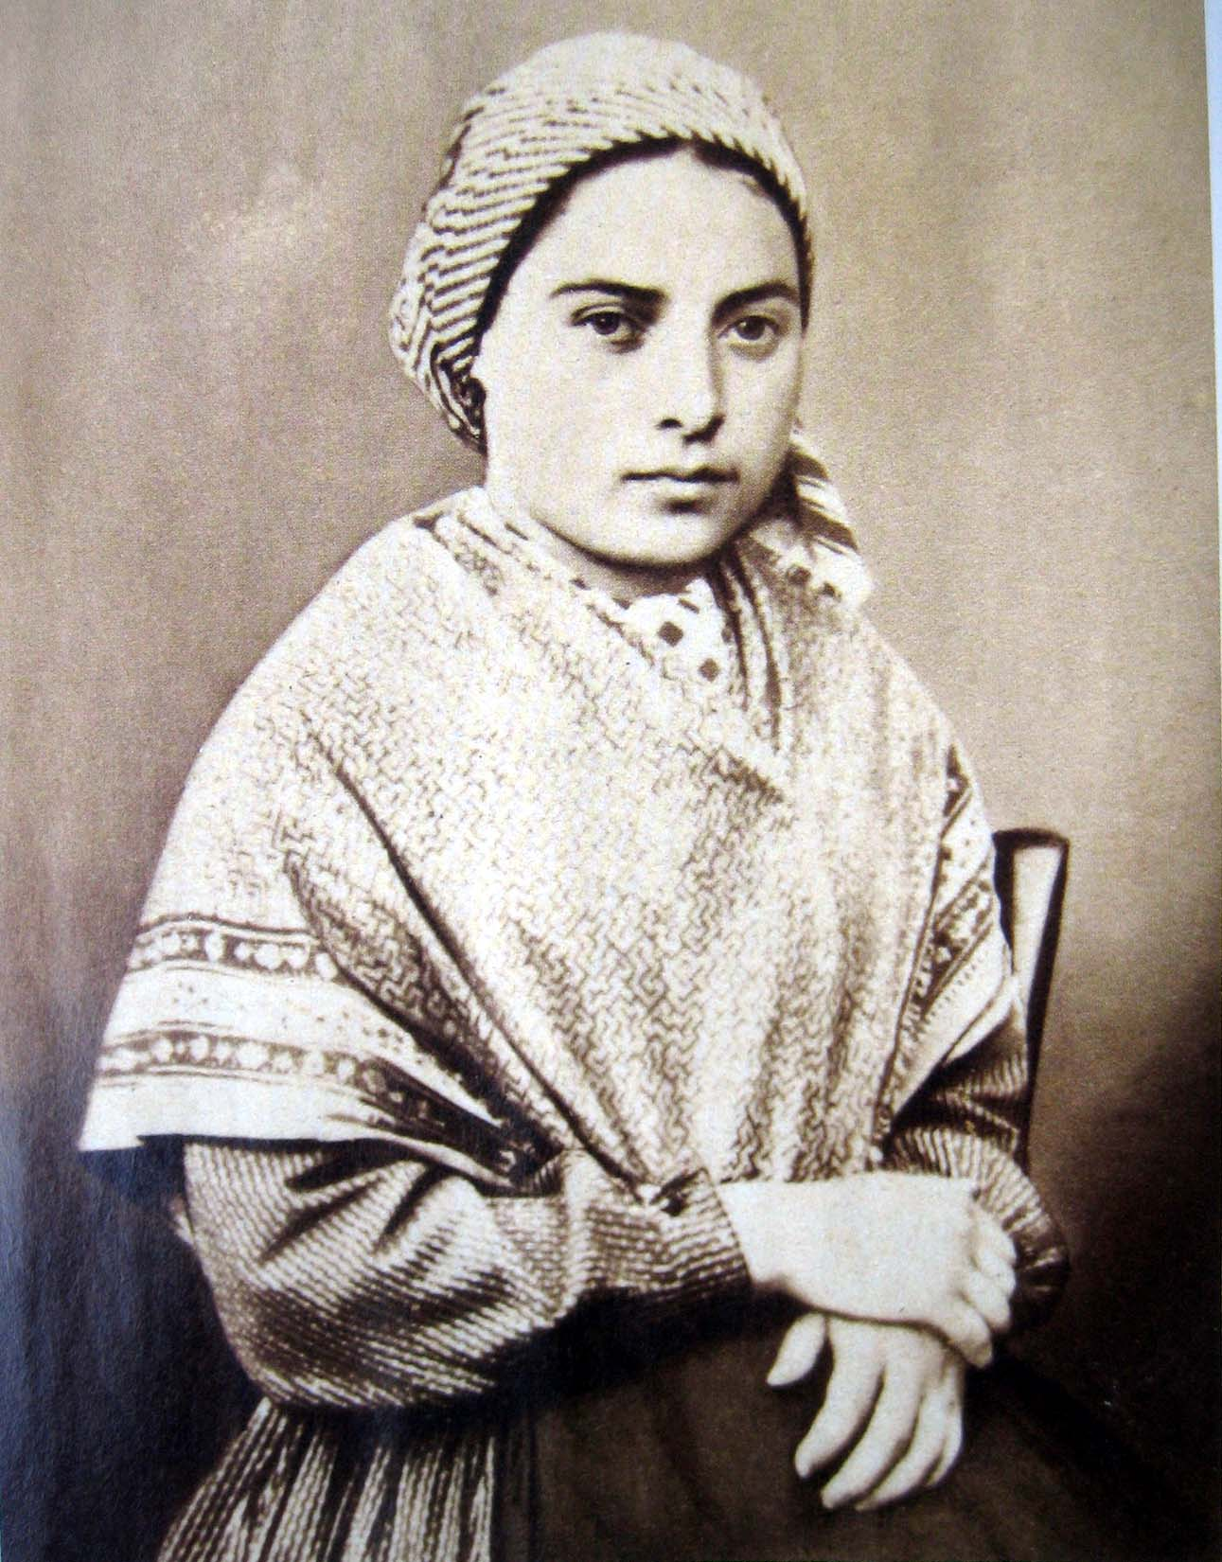
Voices and Spirituality
Spiritual voice experiences can be found in the origins of most religious movements.
Old testament
New testament
Islamic Tradition
Vocation-the call of an inner voice
Modern Christian Leaders
Contemporary Religious experiences
Notes:
Ancient Egypt, Rome, Babylon, Tibet and Greece. Oracles were called upon for guidance.
Old testament-God promised to reveal himself to humans through visions and voices. Eg Moses and the burning bush
New Testament- Angels spoke to Mary. Jesus spoke to God.
The prophet Mohammed received his mandate directly from God through the agency of the arch angel Gabriel
Vocation-St Francis of Assisi, St Teresa. Joan of Arc (1412-1431)-Advice from voices Joan led the French army to victory over the English.
Modern Christian leaders (1624-1691) George Fox formed the Quakers-Commands of God. A vision by Joseph Smith founder of the Mormons spoke to him and by which he was guided.
It appears that the call of a divine voice has led many people to their Christian vocation. Eg 1981 six teenagers began receiving messages from the Virgin Mary, Endorsed by Pope JP 2nd Meedjugorje has become a holy site for worshipers from all over the world.
Saint Bernadette 1858
She said that "the vision" asked her to return to the grotto every day for a fortnight.
This period of almost daily visions came to be known as "holy fortnight." Initially, her parents, especially her mother, were embarrassed and tried to forbid her to go. The local police commissioner called her into his office and threatened to arrest her, as did the district attorney, but since there was no evidence of fraud there was little they could do. The supposed apparition did not identify herself until the seventeenth vision, although the townspeople who believed she was telling the truth assumed she saw the Virgin Mary.
Bernadette's story caused a sensation with the townspeople, who were divided in their opinions on whether or not Bernadette was telling the truth. Some believed her to have a mental illness and demanded she be put in an asylum. Bernadette She explained that the vision had told her "to drink of the water of the spring, to wash in it and to eat the herb that grew there," as an act of penance. To everyone's surprise, the next day the grotto was no longer muddy but clear water flowed.
The Lourdes Commission that examined Bernadette after the visions also ran an intensive analysis on the water and found that, while it had a high mineral content, it contained nothing out of the ordinary that would account for the cures attributed to it. Bernadette herself said that it was faith and prayer that cured the sick.
Her request to the local priest to build a chapel at the site of her visions eventually gave rise to a number of chapels and churches at Lourdes.
In 2008, the 150th anniversary of the 1858 apparitions to Bernadette, it was expected that 8 million pilgrims would visit Lourdes during the year. Lourdes is now a major centre where Catholic pilgrims from around the globe reaffirm their beliefs as they visit the sanctuary.
Bernadette was officially canonized a Saint by Pope Pius XI on 8 December 1933.
The year 2009 was declared "The Year of Bernadette".

Slide 16
Formulation/construct (The startling Phase)
People’s first experience of hearing voices can be very individual, but there may be some common threads with others.
Most voice hearers describe the onset of the experience as being quite sudden, startling and anxiety provoking, and can vividly remember the precise moment they first heard a voice.
Voices may be triggered by traumatic or emotional events such as accidents, divorce or bereavement, illnesses, abuse.
Can you remember what your first experience of hearing voices was like? Write it down in as much detail as you feel comfortable with. Where, when, what did you think was going on, how did you feel, what did you do. What impact did this experience have on your life, friends, family, school, work etc..
Notes:
“I started hearing voices when I was 14, I had a very difficult time. My parents were in the process of splitting up, at the same time two grand parents passed away, I also was being bullied by the head boy and I had been hacking into computers at school, some one else got the blame and was expelled from school, I felt very guilty, but unable to own up. I didn’t tell anybody. I stopped going to school just telling them I was not feeling well”.
“I was 17 when I started to hear three voices. I had just started living on my own and changed schools. I went to a special science school were we concentrated on mathematics. I then had real difficulties with mathematics I had had never before. I sat at my desk for three hours one day not knowing were to start when I heard a clear voice saying: .”you are stupid”
“On a Sunday morning at 10 o’clock, it was as if I had received a totally unexpected and enormous blow to my head. I was given a message although I was alone. I panicked, thought “what is happening?” then I thought I must be imagining it but I had to take it seriously.”
“As a child I had a number of voices in my head. I had two egos, a child ego and an adult ego, each with their own language. As a child I never found this strange.”
“After leaving secondary school I moved into my own flat. It was great fun but I didn’t eat enough or sleep enough. I decided to paint a large white wall with a mural of a dark forest. I have always been able to hear colours and in the stillness of the room as I painted I felt the alarming growth of a threatening presence. I heard in my ear a low, monotonous, unexplainable noise that I felt was not from myself. I no longer felt alone in the room.”
“The positive voices were suddenly accompanied by nasty crooks. They came from everywhere: In my head, behind me, in front of me, like telephone lines inside my head.”

Slide 17
Influencing Beliefs Some of the common tactics of voices
They do not like you to talk about them with others.
They do not like you attending hearing voices groups.
They may not come to you straight after a stressful event but wait sometimes for days.
They like to have your full attention so will often wait until you are in a space where there is nothing to compete with your attention.
They like to be secretive and will often punish you if you discuss them with others.
They undermine you and fill you with doubt.
They lie to you.
They like to create an environment of fear because they need fear to flourish.
They interfere with relationships and make it very difficult to be around people.
They are jealous and do not like to share you with others.
They call you names and bully you.
They don’t like you to enjoy yourself especially with others and will find ways to disrupt your enjoyment.
They know all your vulnerabilities and how to ‘needle you’.
They threaten you and those whom you care about.
They always have an answer when things go wrong as to why it was your fault.
They never take responsibility for anything they say or do rather they let you endure the consequences.
The encourage you to be alone and isolate yourself.
They can be very entertaining and take up lots of your time which means you do not have the time nor energy to cultivate other relationships.
Notes:
From Deborah Lampshire’s group work in NZ.
Starting to influence beliefs
Generate a conversation explore the tactics of voices. People will start to share their own experiences with examples again explore similarities and differences. All opinions are to be respected. People generally start to offer ideas and support to each other. This session can help reframe some ideas about power, choice and control.

Slide 18
Influencing Beliefs Look at widely held beliefs
ESP 50%
Haunted houses 42%
Devil possession 41%
Ghosts and spirits 38%
Telepathy 36%
Witches 26%
Reincarnation 25%
Talking to the dead 28%
Astrology 28%
Notes:
All of these unusual beliefs are widely held so it makes sense that they might influence an individuals belief about the origins of voices.
Unusual beliefs are normal. If you are a sceptic then you are the odd one out.

Slide 19
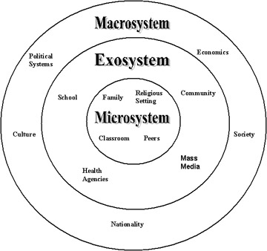
Why do we believe what we believe
Gender, age, education, culture, family, politics, friends, TV, books.
Religion, peer pressure, experts, stories, tradition, direct observation, theories.
Ideologies, self interest.
Nationality, society.
Notes:
Here is a summary of explanations from previous groups of Beliefs about the origins of voices
Special gift
Witchcraft
Devils, demons
Angels
Dead people, spirits
Voice to skull weapons
Government chip implanted
Government computers, advanced technology
Aliens
A manifestation of my own thoughts
Inner speech

Slide 20
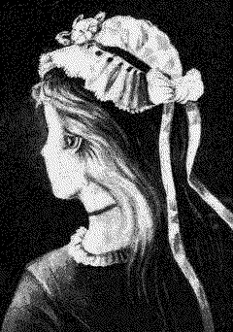
Things aren’t always what they seem
Notes:
Look at things differently
Maybe the voices are not as powerful as I first thought?
Maybe Its not possession?

Slide 21
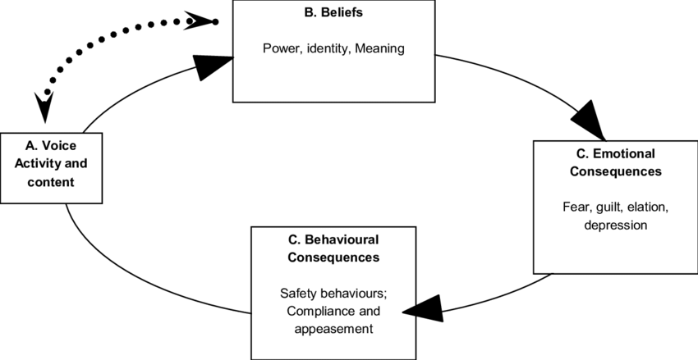
The Cognitive Model Of Voices. Think Differently
Voice Activity | Belief | Thought | Feeling | Behaviour | Result
Kill yourself | “It’s a demon. Powerful. Omnipotent. | “If I don’t do what it says, I will be killed. My family will be killed. The demon is powerful. | Terrified | Self-harm or even attempt suicide | Hospital Admission Injury or death
Kill yourself | “Inner speech. My own thoughts” What does it represent? | “I must be stressed out. I should do something about it” | Okay | Go fishing | Happy days!
Notes:
What would life be like if you think differently
The cognitive model of voice hearing (Chadwick & Birchwood, 1994) suggests that distress associated with auditory hallucinations is best understood in terms of beliefs about voices. Researchers have consistently demonstrated that one of the most important distinctions between those who cope with the experience of hearing voices and those who do not cope appears to be how they perceive their voices (Haddock et al., 1999).
Some voice hearers construed their voices as benevolent others as malevolent and persecutory. Voices believed to be malevolent are associated with resistance and high distress, in contrast to those believed to be benevolent, which are associated with engagement and lower distress. Chadwick and Birchwood’s (1994; 1997)

Slide 22


Change the relationship with voices Influence the power Compassion for Voices
Notes:
Charlie Herriot Maitland – Compassion Focussed Therapy -
https://www.youtube.com/watch?v=doYFkPMyuCk
If you get the chance attend workshops Eleanor Longden and Charlie Herriot Maitland
Exploring and trying to make sense of voices

Slide 23
Testing the power of Voices
Thought to be tested: My voice is very powerful
Belief in thought (0-100%) before experiment 100% After experiment 50%
Experiment to test thought Wash the pots | Likely problems The voices will punish me for challenging them. Things will get worse. | Strategies to deal with problems I have nothing to loose. | Expected Outcome The pots are washed | Actual Outcome The pots are not washed | Alternative thought my voice is not as powerful as I thought
Notes:
Power has been defined as the ‘beliefs an individual makes about how much they can or cannot control the voice and how much they need to comply. (Birchwood and Trower 2006)
Example. Deborah Lampshire asked her dominant voice to wash the pots when she went to bed. The voice had all night to complete this simple task. If the pots were washed then she would comply. When she woke in the morning the pots were unwashed.

Slide 24

Things to think about
Are voices all bad?
Are voices normal?
When does a voice become an auditory hallucination?
Notes:
Several factors may contribute to how people cope with hearing voices including their experience of different life events, the level and type of support they receive, individual personality traits and characteristics, and opportunities to make sense of what is happening to them (Bentall, 2003).
According to Romme and Escher (1989, 2000) voice-hearers tend to pass through three phases. The first is a “startling phase”, associated with the sudden onset of the voices, which can be a frightening and confusing time for people. The “organisation phase” is next where voice-hearers begin the process of acceptance and communication with voices. The third phase is the “stabilization phase”, a time of stability related to the development of on-going sustainable coping strategies. If we can understand the differences between those who cope or stabilise versus those who do not, we can further develop effective treatment (Corstens et al., 2012; McCarthy-Jones & Longden, 2013).

Slide 25
Questions
Kayg50449@gmail.com
Kay, G., Kendall, E., & Dark, F. (2017). Are hearing voices networks compatible with cognitive behavioural therapy for psychosis? Australian Social Work, 70(3), 312-323
Kay, G., & Kendall, E. (2017). Response to Brophy (2017). commentary on "responding to the needs of voice-hearers and expanding access to evidence-based and innovative psychosocial interventions" (Gordon Kay, Elizabeth Kendall, & Frances Dark, 2017). Australian Social Work, 70(4), 511-513
Kay, G., Slattery, M., & Kendall, E. (2021). The facilitators’ perspectives of delivering a ‘Coping with Voices’ group (Part 1). Psychosis, 1-11.
Kay, G., Kendall, E., Slattery, M., Scott, J., Gore-Jones, V., & Dark, F. (2021). Results from a quasi-controlled trial of a “Coping with Voices” group. Part 2. Psychosis, 1-11.

