Slide 1

Voices of death, dying and grief: Exploring suicidality, death and grief in relation to unusual experiences
Jane Faulkner and Fiona Malpass

Slide 2

Outline for today
Introduction and guidelines
Icebreaker
Scene setting: Hearing Voices and Suicidality
Support: What does that look like?
Language matters
Check out
Feedback (optional)

Slide 3
Group guidelines
Confidentiality
Personal information stays in the room, but it’s OK to share themes to help spread the word
Be respectful
Try not to interrupt when someone is speaking, don’t speak over someone, keep your mobile off etc.
We are all here to learn
Each of us has something to offer to course. Whilst we are all from different backgrounds, we are equals.
It’s your choice
All activities and discussions are optional. Take part in as much as you can
Self-care
Look after yourself, know your own limits and make a choice about what you share and what you keep private.
Embrace diversity
Try to be curious about difference of opinion and learn from one another. There is rarely a ‘right’ answer.
It’s OK to disagree but own your own views and keep it respectful.
Share the space
If you’re confident in groups, remember to leave space for those who may be a little quieter.

Slide 4
Icebreaker
In threes, can you share your name, and use an example of weather to describe how you are feeling right now.

Slide 5
Setting the scene

Slide 6



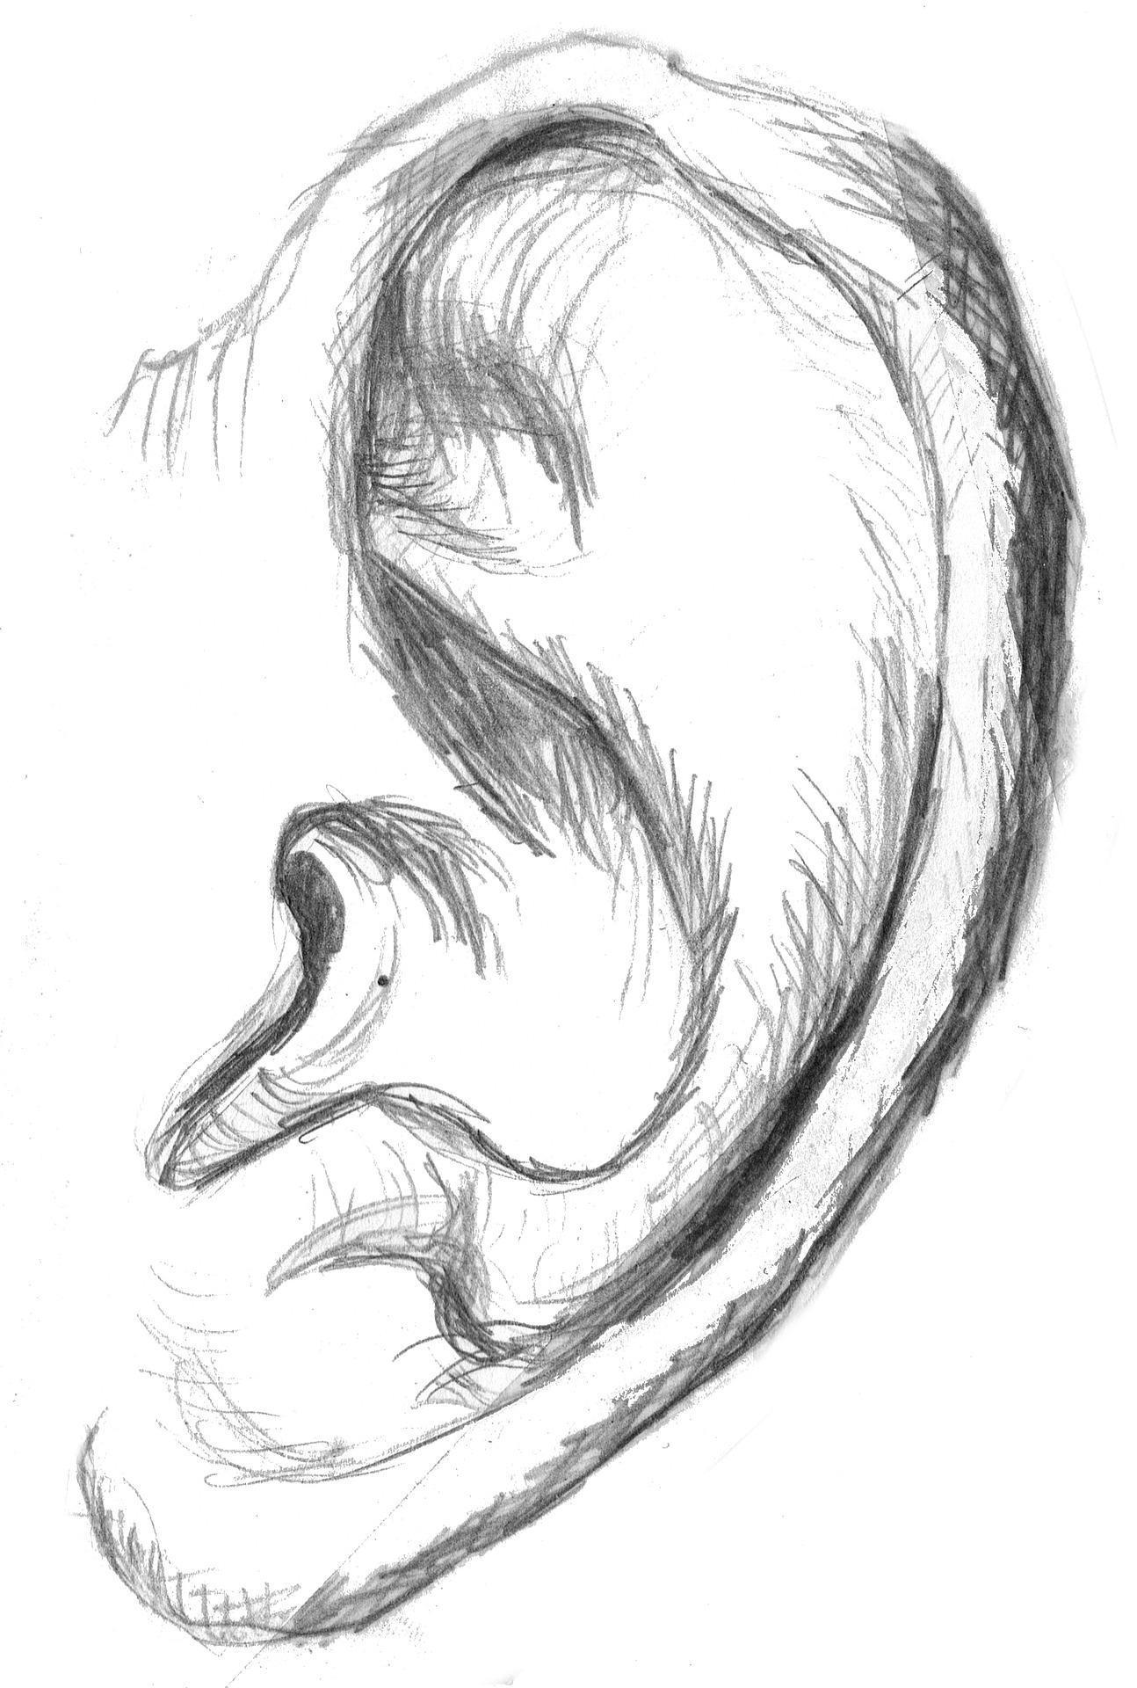
‘Hearing Voices’
What do we mean?
When we talk about Hearing Voices we are describing the experience an individual hearing something that others don’t.
It’s also an umbrella term to include experience of visions, taste, smells and touch, which others may not share.
Notes:
What do we mean by ‘Hearing Voices’
When we talk about Hearing Voices we are describing the experience an individual hearing something that others don’t. Voices themselves can be internal or external, they can be loud, quiet, constant, or only be heard at certain moments. Some can be engaged with in conversation, some can’t. In addition we include things like music, bangs, crashes, hisses...generally noise that if you turned to your friends or family and asked ‘Can you hear that’ they wouldn’t be able to.
We also include experience of visions, taste, smell and touch which others may not share. For example, being in a room on your room but feeling someone’s hand on your shoulder. Whenever we say voice hearer, please do assume we are also including vision, smell and touch.

Slide 7

Suicidality
What do we mean?
Suicidality is, much like ‘Hearing Voices’ an umbrella term for a wide variety of experiences.
It does not necessarily mean that someone is actively planning to kill themselves. It can range from regular thoughts of suicide, to living with wanting to die, to a consistent existential angst about the past, present of future.
Notes:
Suicidality is, much like ‘Hearing Voices’ an umbrella term for a wide variety of experiences.
It does not necessarily mean that someone is actively planning to kill themselves (although someone might). It can range from regular thoughts of suicide, to living with wanting to die, to a consistent exestential angst about the past, present of future.
It can also be a very lonely experience, as expressing these thoughts, like hearing voices is a stigmatised and misunderstood experience.

Slide 8

Bridging the conversation
Often these experience are spoken about separately but often co-occur.
If you live with suicidality and you are having visions of hanging, this can exacerbate the struggle. If you have a plan but your voices are talking about reasons to live, this can be helpful.
Does hearing a voice telling you to take your own life resonate with your own suicidal feelings, or does it contradict your strong will to live?
Notes:
Often these experience are spoken about separately, but for the individual that can be happening concurrently. The intersection and interplay between the two can be challenging or can be supportive.
If you live with suicidality and you are having visions of hanging, this can exacerbate the struggle. If you have a plan but your voices are talking about the reasons to live, this can be helpful.
Often we we talk about our experiences, we also separate the discussion. How helpful is this for us? What would it be like to say ‘today I am struggling to stay alive, and all I can smell is decay’? Or ‘today I really want to live but I can’t feel my body’ to someone else?

Slide 9
Hearing voices movement
The hearing voices movement has made great strides in developing and promoting non-pathologising approaches rooted in compassion, as well as viewing hearing voices as not always being negative, and having meaningful connotations.

Slide 10
Applying this to suicidality?
Thinking about suicide, even planning a suicide, can be a way of coping – people have found writing wills, suicide notes, etc, a comfort and has helped them get through.
Questioning the purpose of life, contemplating death, can be spiritual or philosophical.
Can be in response to oppression and marginalisation, or other difficult life/world circumstances. “One cannot be deeply responsive to the world without being saddened very often.” – Erich Fromm
Can be a sign of a need for change, an opportunity for growth. “There is no love of life without despair of life.” – Albert Camus
Can have positive implications, helping people feel more in touch with life, through contemplating or desiring death. “Once you have perceived that life is very cruel, the only response is to live with as much humanity, humour and freedom as you can.” – Sarah Kane

Slide 11
Intersections Assumptions
Often misunderstood
Both have the potential to be incredibly overwhelming and distressing
Both have the potential to bring comfort or a way of coping
More common than people think
Can be explored through being curious and compassionate
Voices can be linked to existential crisis, as well as grief and mourning.
Mental health services and interventions or treatments will work/be helpful
People shouldn’t have these experiences
Talking to someone about it is useful
It is wrong/irrational
It is part of mental illness
It should be prevented
Talking about it in detail is ‘colluding’ with the experience
It is risky/dangerous

Slide 12
Activity
Think about your experience of times when hearing voices and suicidality have intersected.
Using the images that are available on your table (or creating your own), pick those that resonate with you.

Slide 13
Support: What does that look like?

Slide 14
Activity
In pairs, can you each describe and write down a time when someone or something was:
Helpful or supportive
Unhelpful or challenging

Slide 15

Language matters
When you hear the word suicide or suicidality, what comes to mind?
The word suicide or suicidality itself has a long, difficult history behind it. Is there a better way to describe the experience? (Examples: existential crisis/angst, a response to hostile environments, unliveable lives)
Notes:
We all know how important language can be. This weekend we are all attempting to communicate with people who may not share the same language as us.
This also happens between those with lived experience and those who don’t. For example, we may understand when a peer says that the voices are loud or quiet. That won’t be the case for everyone we come into contact with.
We may have a friend we can ask ‘Can you see that person in the corner’ or a family member we can say ‘Today is a floor day’ but this might not mean anything to the train driver.
The word suicide or suidality itself has a long, difficult history behind it. Is there a better way to describe the experience?
*Image: https://hyperboleandahalf.blogspot.com/2011/10/adventures-in-depression.html

Slide 16
Activity
What is missing in support around hearing voices and not wanting to live or wanting to die?
What would you want from resources that focus on this topic?
What would you want people to know about these experiences?

Slide 17




Check out
What are you taking away from the conversation today?
What would you like to feedback?
What are you leaving here?
What can you do right now that is kind to yourself?

Slide 18
Thank you!
fmalpass@mindincamden.org.uk
Mind in Camden
15-19 Barnes House
Camden Road
London
NW1 9LQ
@FionaMalpass
jfaulkner@mindincamden.org.uk
Mind in Camden
15-19 Barnes House
Camden Road
London
NW1 9LQ

