Slide 1
Spiritual and Cultural Frameworks
Caroline Mazel-Carlton
Wildflower Alliance
Hearing Voices Network - USA

Slide 2


Slide 3

Trauma
One Voice
Gender
Past Life
Sleep Disturbance

Slide 4
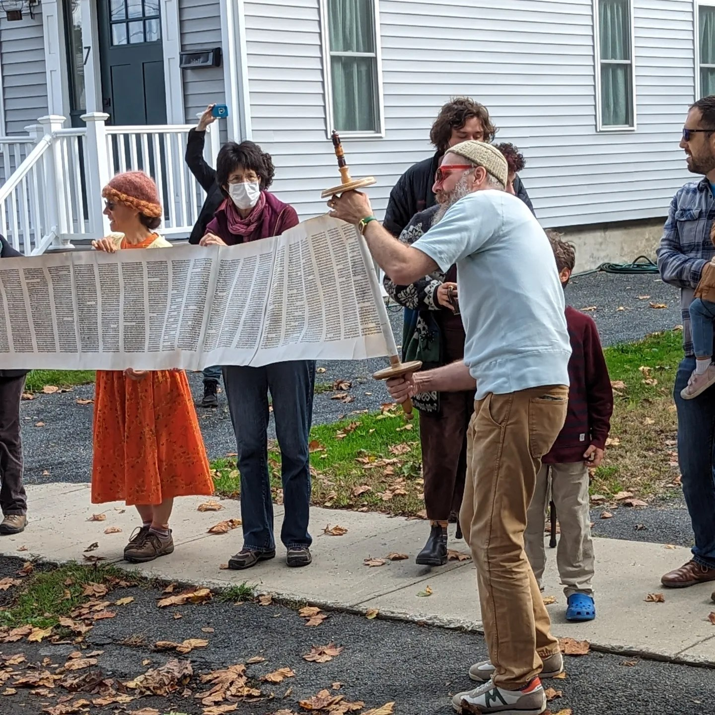
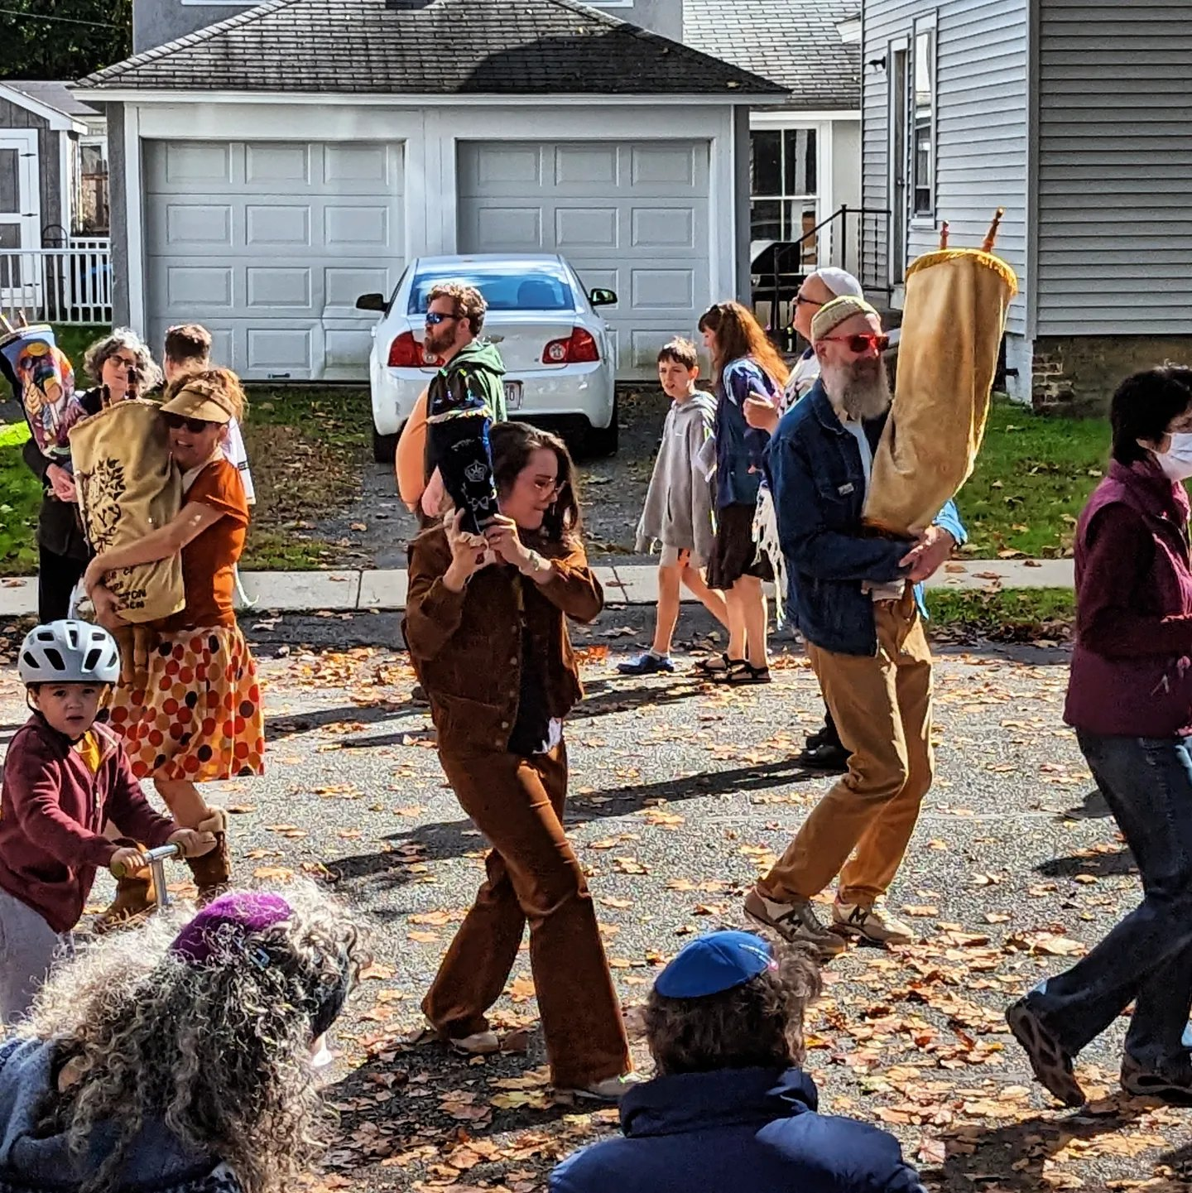


Slide 5



Slide 6

"Fear is the cheapest room in the house. I would love to see you living in better conditions”. -Hafez Shirazi

Slide 7


